Slide 1
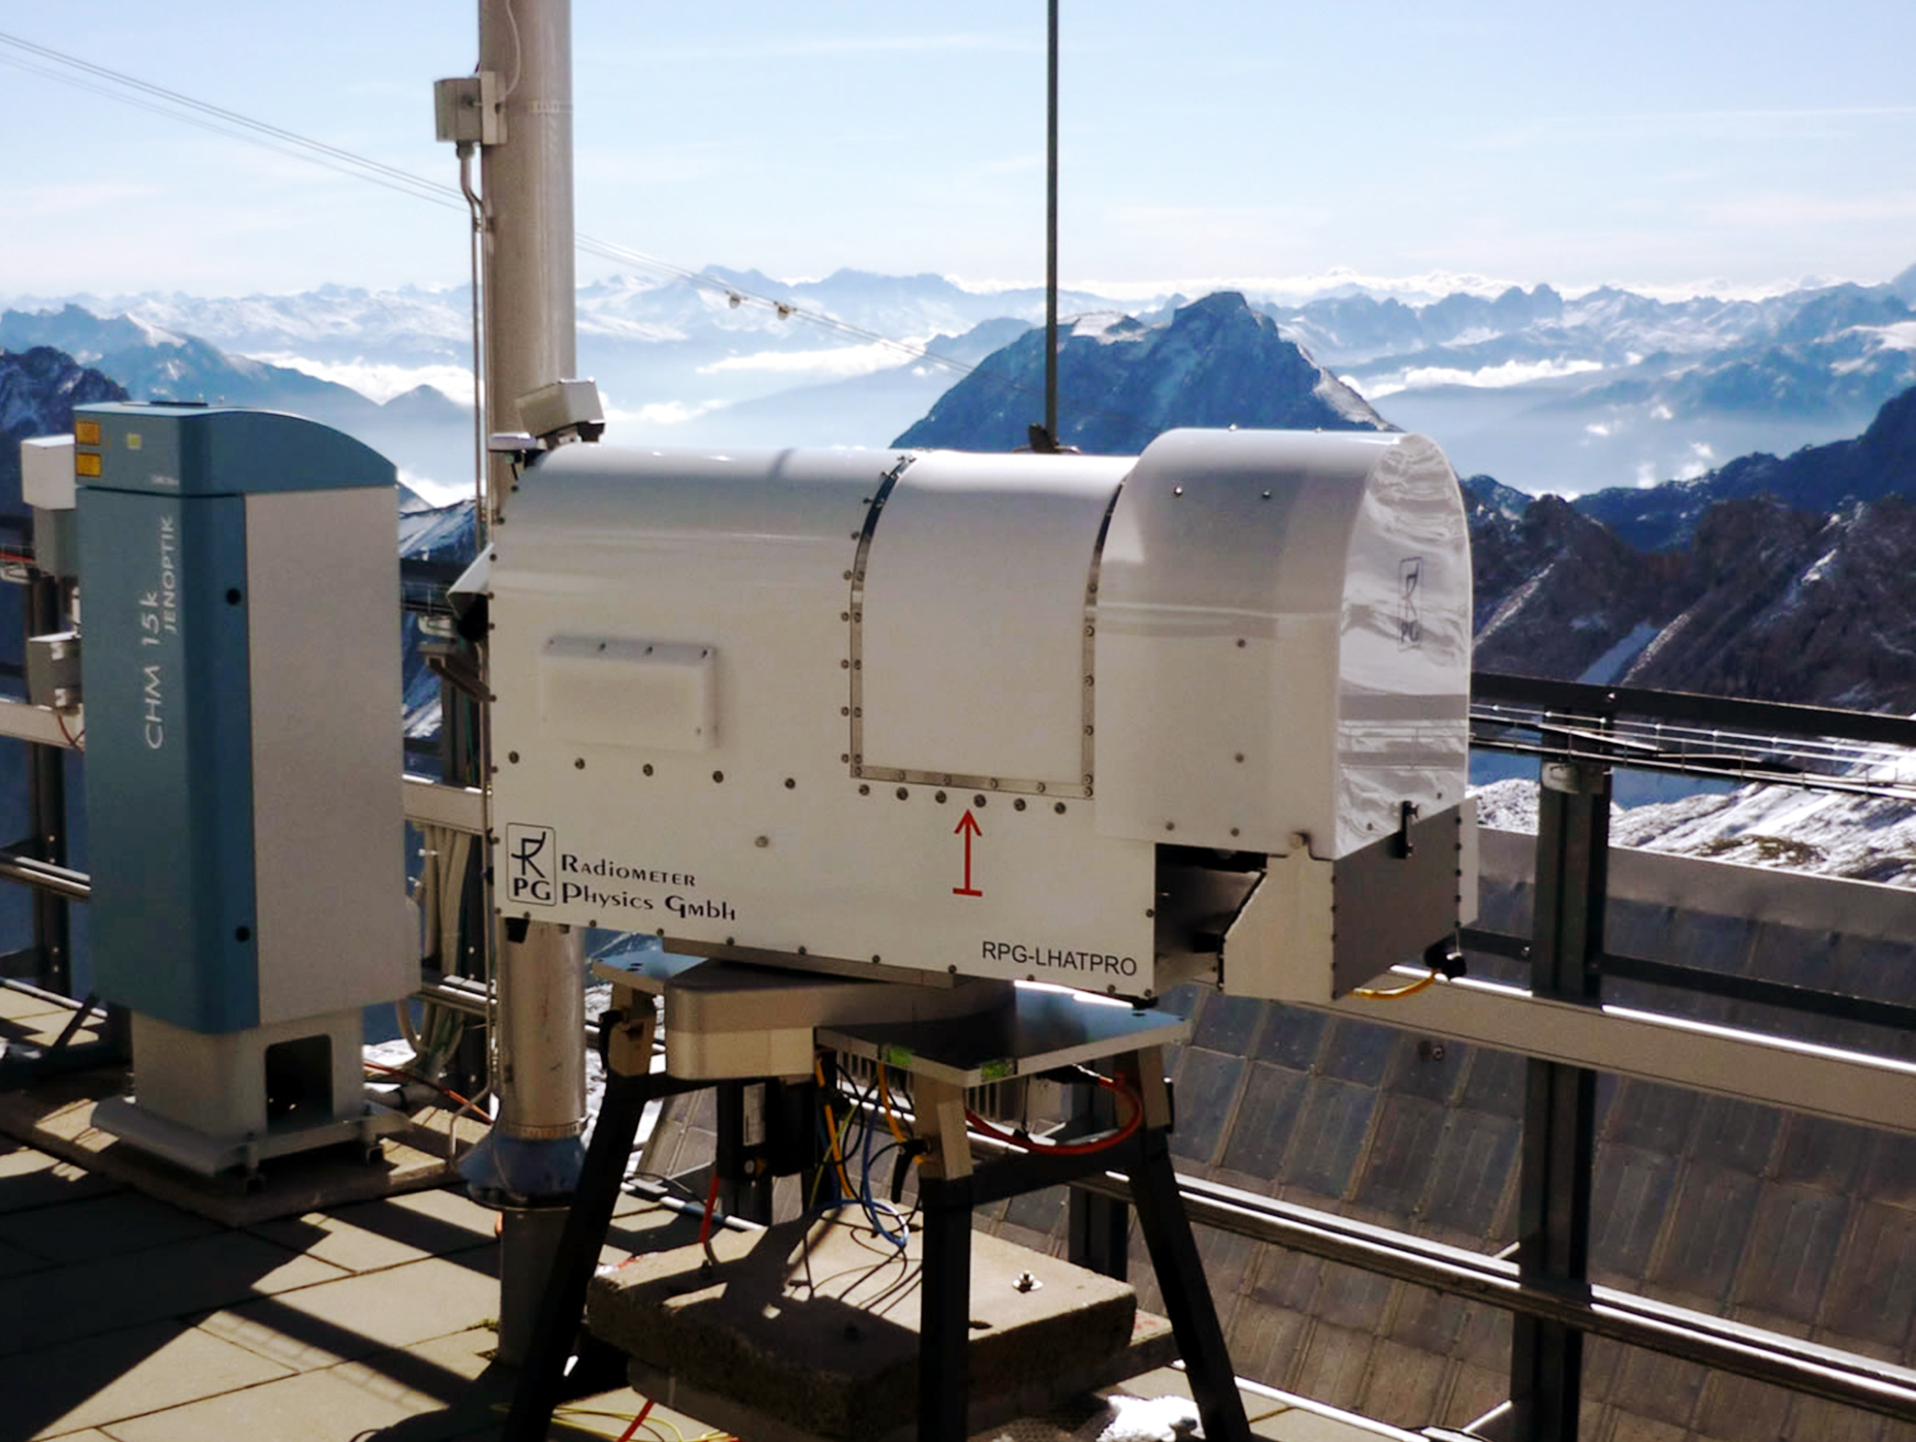
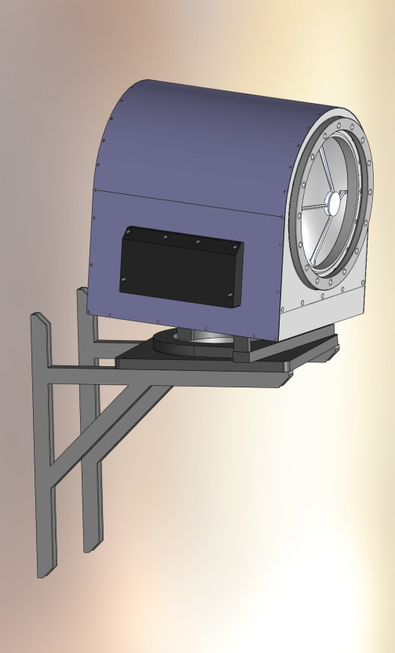
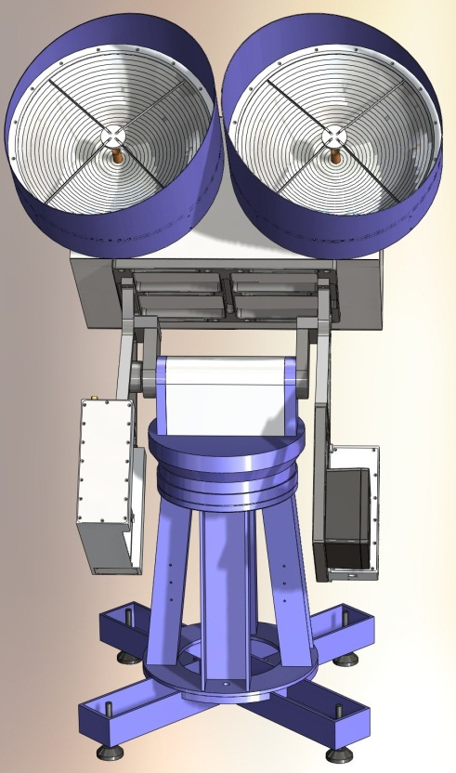
Microwave Remote Sensing of the Boundary Layer
Harald Czekala¹, Oscar Hartogensis², Martin Philipp¹, Thomas Rose¹
1: RPG Radiometer Physics GmbH, Meckenheim, Germany
2: Wageningen University, Wageningen, The Netherlands

Slide 2
Outline
Passive microwave radiometer for Boundary Layer (BL) T-profiling:
The concept of elevation scans with saturated channels
The expected signal
Requirements on instrument design / receiver improvement
Active / Scintillometry:
Concept of direct measurement of latent heat flux (evapotranspiration) (when combined with optical scintillometer)
Design of Transmit/Receive system at 160.8 GHz
Prototype assembly
Active / FMCW cloud radar at 94 GHz
Concept, design drivers
Preliminary Instrument specifications
Summary / Conclusions

Slide 3
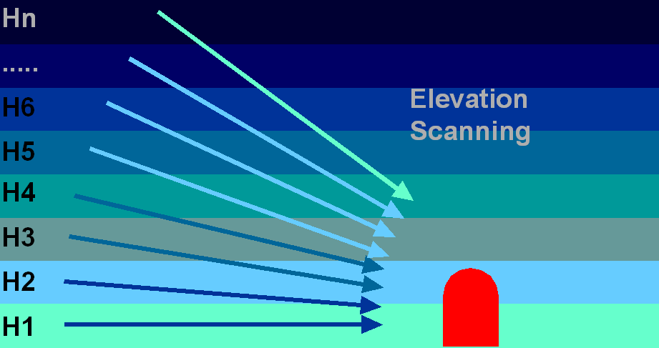
µ-wave BL-Temperature Profiling: The Concept
Absorption length decreases for frequencies at line center (60 GHz)
Limited (approx. 600 m) emission depth @ 58 GHz
Weighting functions shifted towards surface by elevation scans

Slide 4
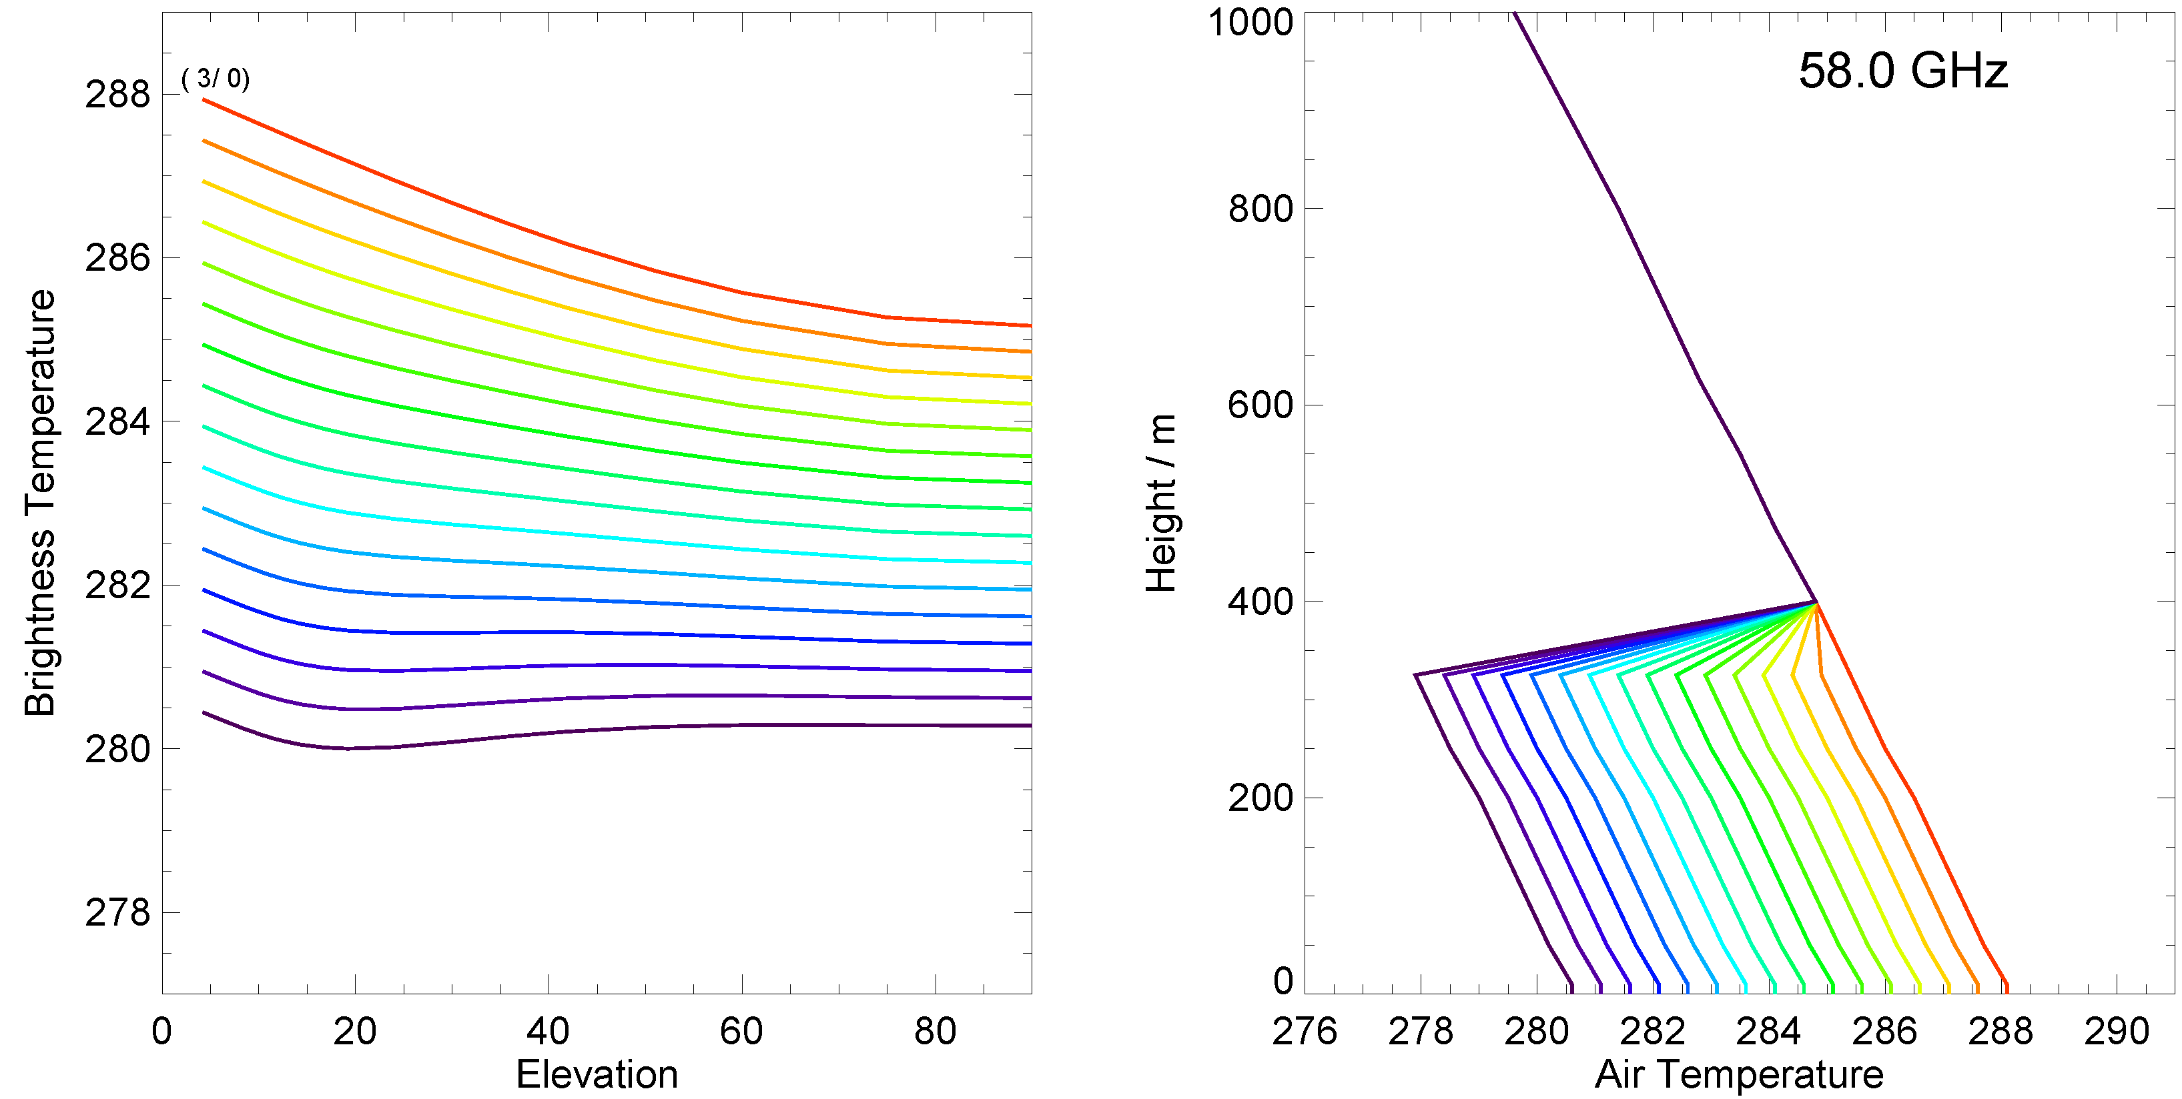
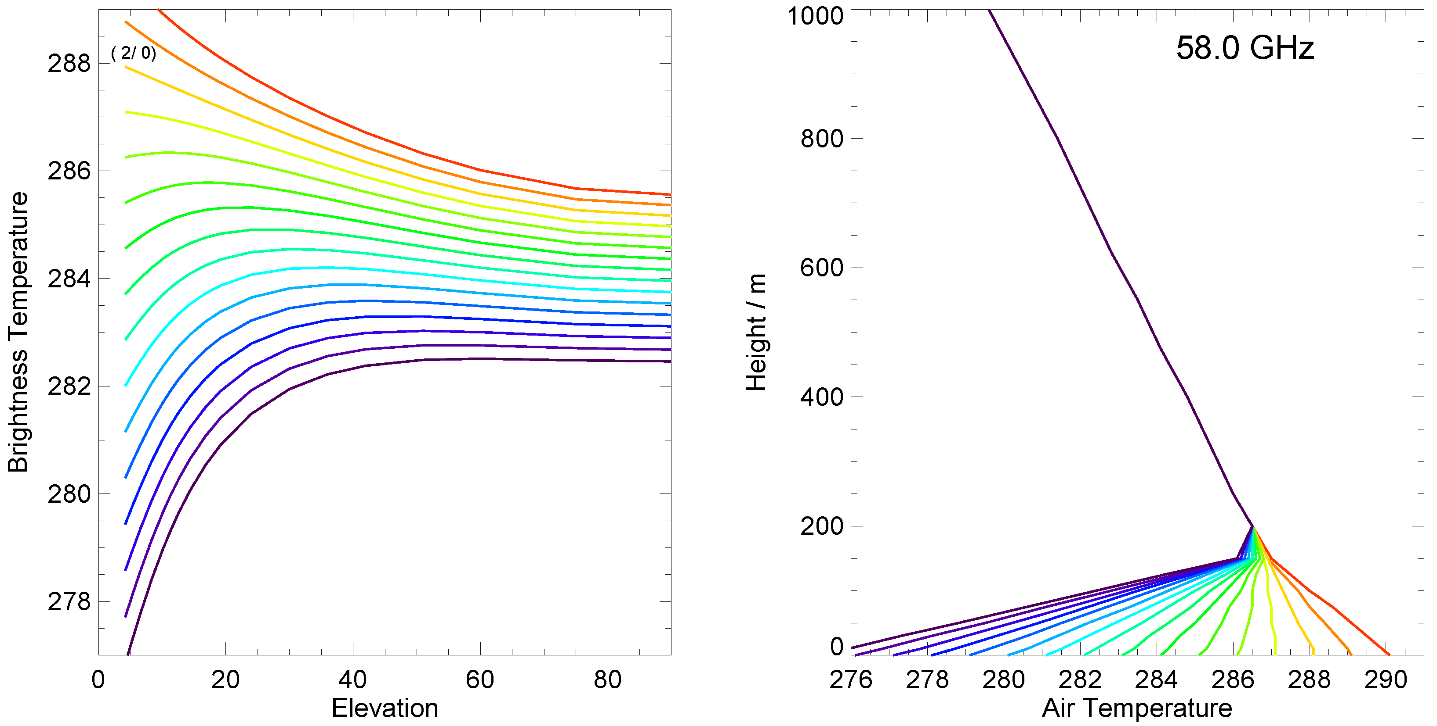
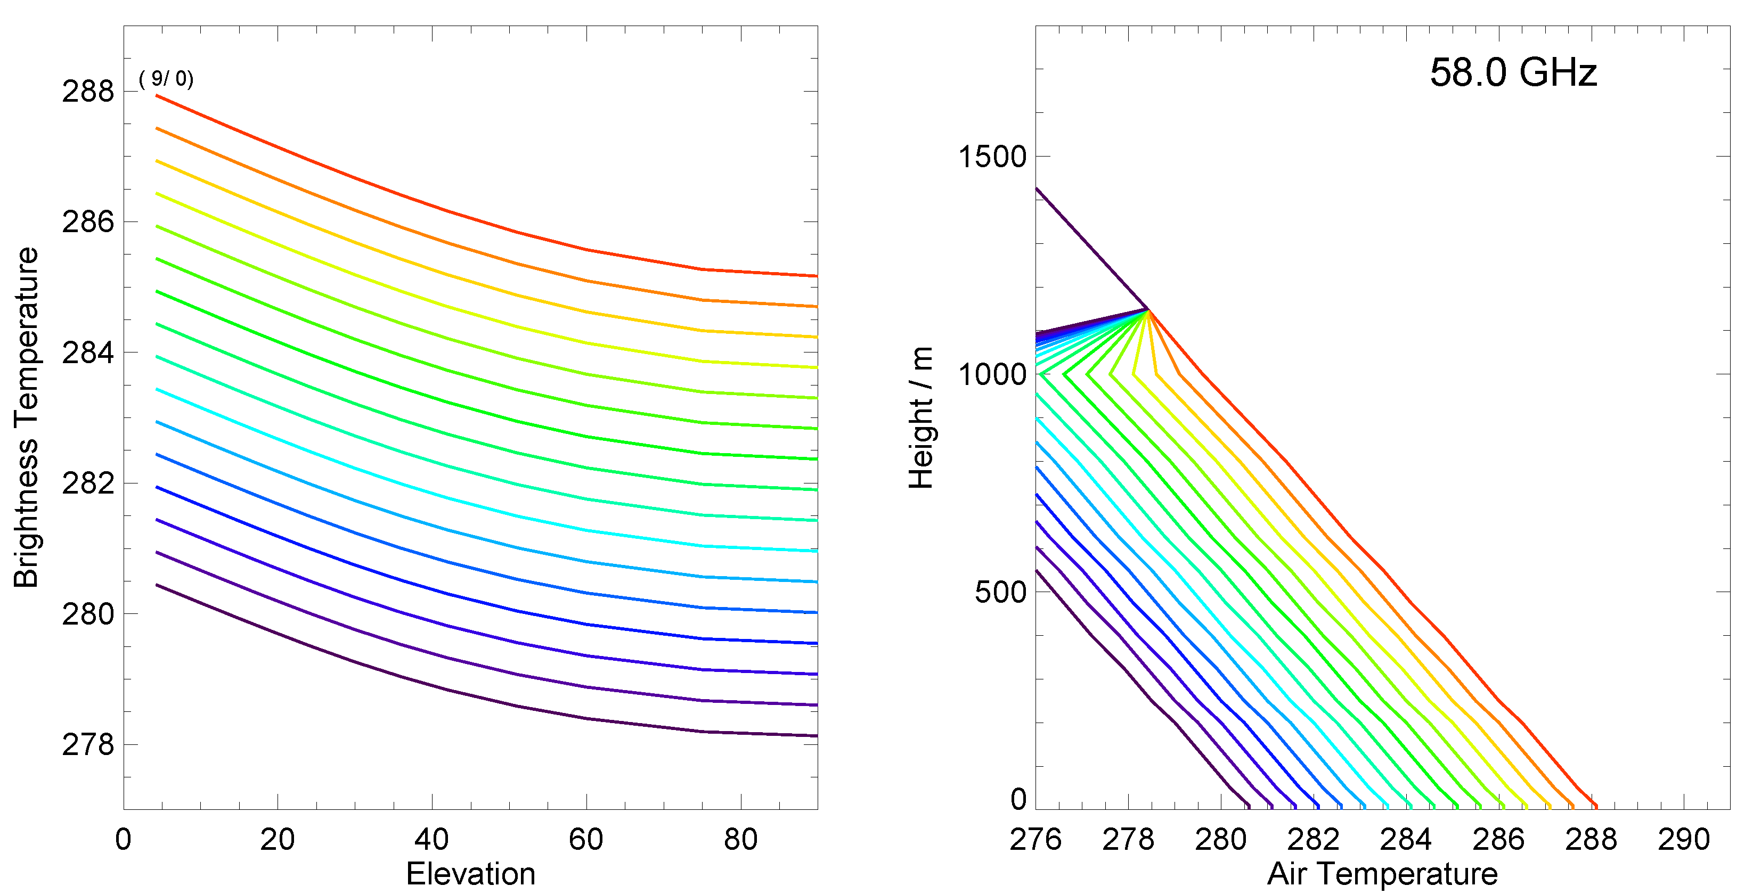
Simulated TB Signature of BL-T-profiles
Small TB variation
on top of large signal
2.5 K signal
1.0 K signal
Low-Level inv.:
clear signal
curvature)
Lifted inv. difficult
(parallel lines)
→ Channels with lower saturation

Slide 5
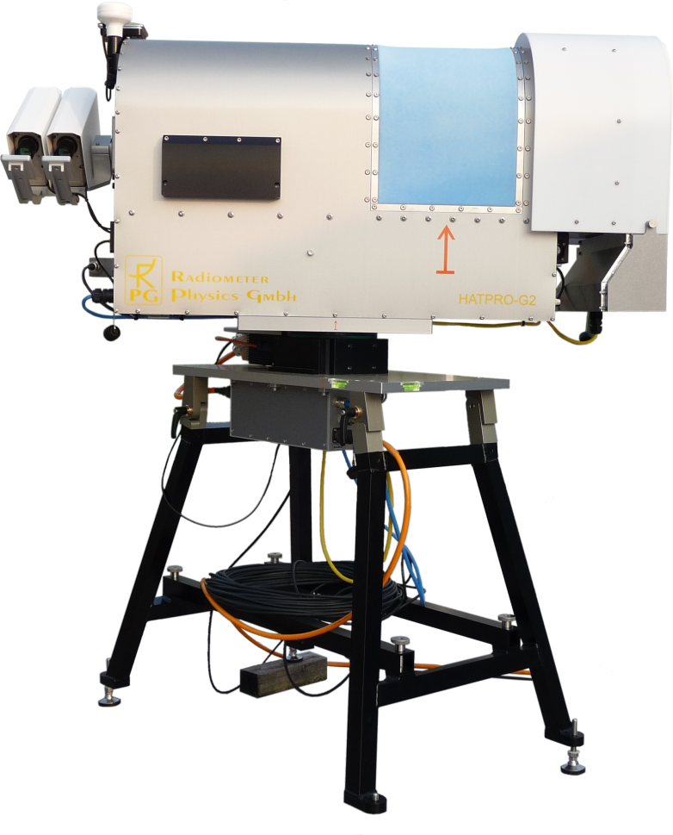
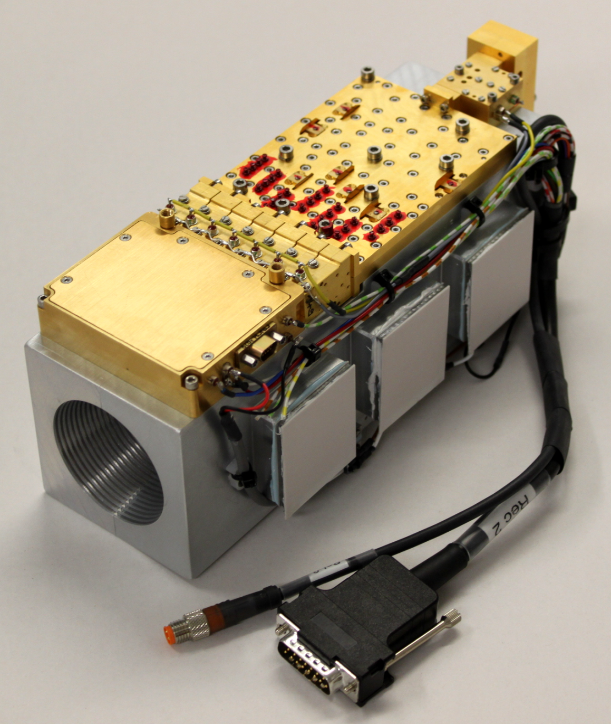
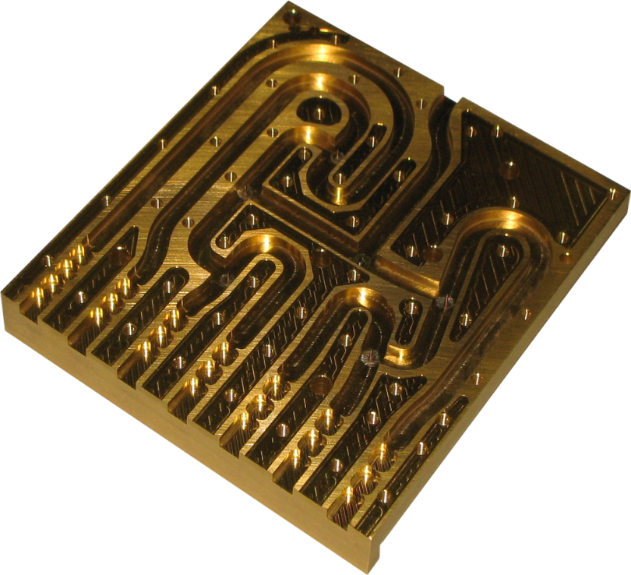
µ-wave BL-Temperature Profiling: The Instrument
HATPRO Direct Detection Filterbank Profiler (parallel data aquisition 14 ch.)
7-channel
V-Band
Receiver

Slide 6
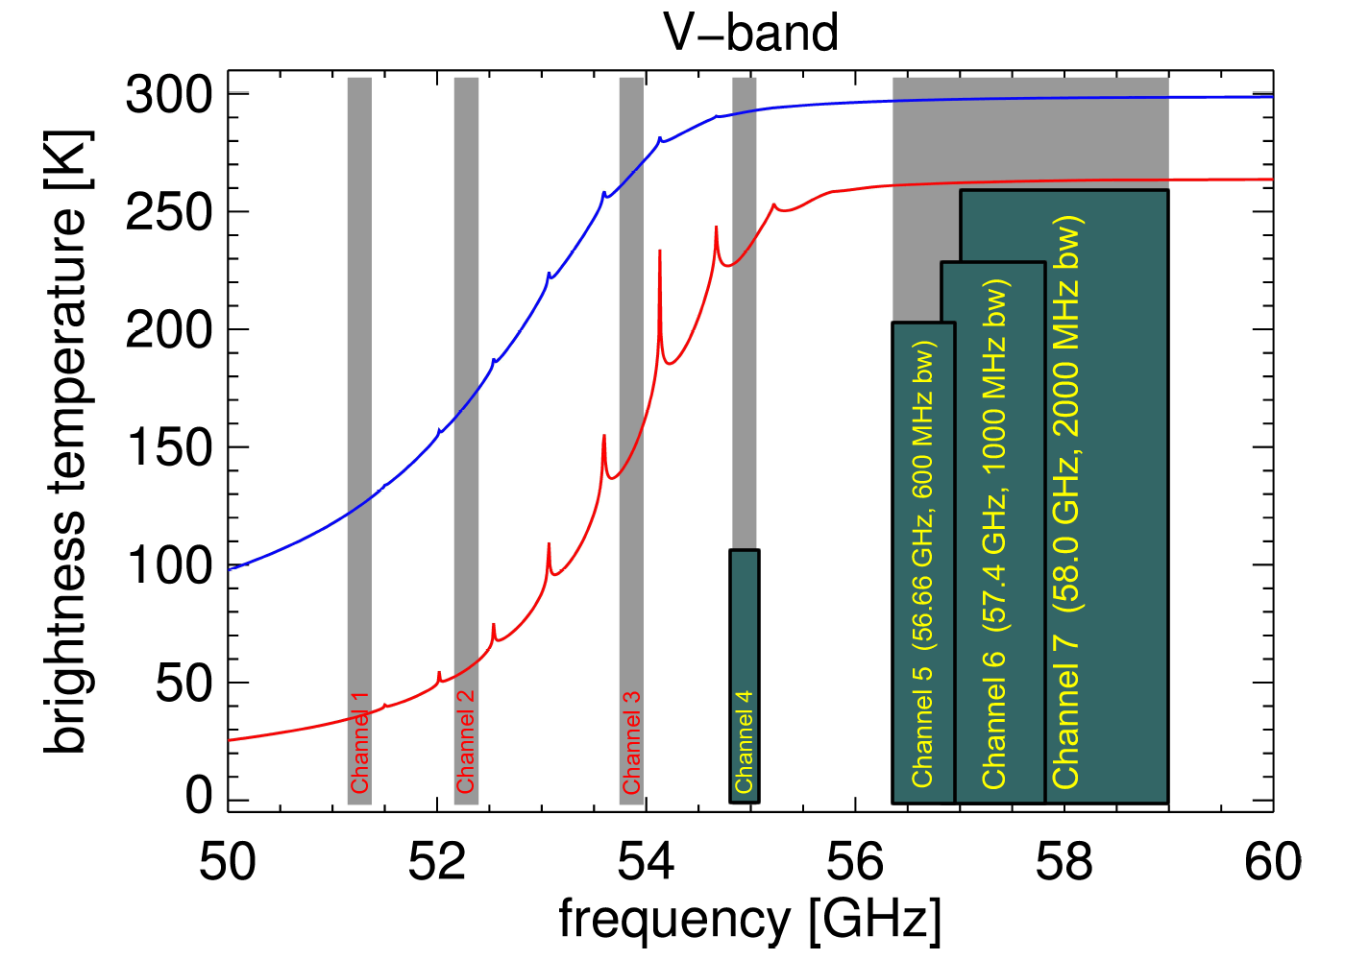
MWR Design Driver: Noise Reductionat 58 GHz
To resolve shape of temperature profile, the radiometer needs
Increased bandwidth at saturated channels only (2000 MHz vs. 230 MHz, noise reduction 1:3)
Increased integration time: 15 s
Multi-channel obs. (in parallel) to avoid saturation (limited range)
Large optics, small beam
Recent developments:
Space qualified/optimised RF amplifiers from UMS
Better noise temperature
Better 1/f performance (MMIC material GaAs vs. InP)
Better calibration repeatability (standing wave problem solved)
RMS TB₅₈ < 0.05 K
1.8°
300 K full system
Courtesy of Gerrit Maschwitz, University of Cologne, Germany

Slide 7
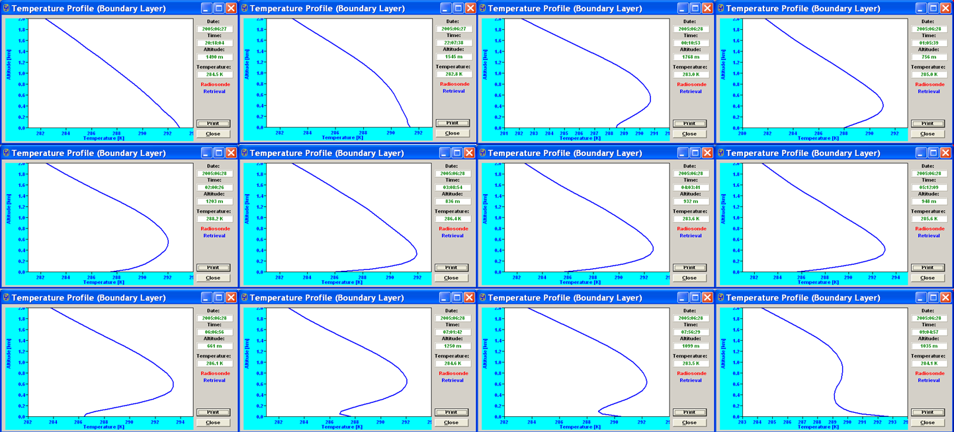
Result: Time Series of Temperature Inversion
Regression Retrievals: Elevation angles, airmass, and channel usage
Regr. | 90° | 30° | 19.2° | 14.4° | 11.4° | 8.4° | 6.6° | 4.8°
Linear | 1 – 7 | 4 – 7 | 4 – 7 | 6 + 7 | 6 + 7 | 7 | 7 | 7
Quad. | 1 – 7 | – | – | – | – | – | – | –
Airm. | 1.00 | 2.00 | 3.04 | 4.02 | 5.05 | 6.84 | 8.70 | 11.95

Slide 8
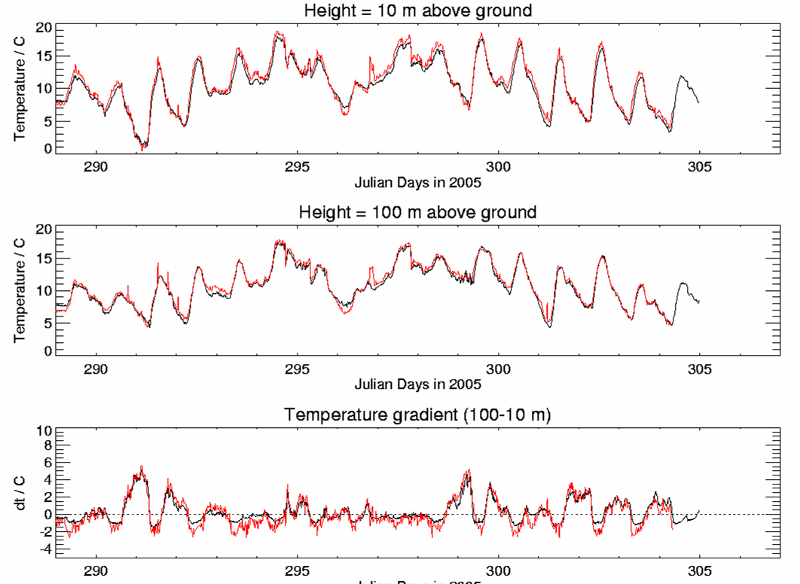
Comparison with Mast data: 15 day time series
10 m temperature:
Black: mast, red: MWR
100 m temperature:
Black: mast, red: MWR
Temp. Gradient: show
lapse rate vs. inversions
Courtesy of Susanne Crewell, University of Cologne, Germany

Slide 9
RPG-MMWS-160
A Millimeter-wave Scintillometer
for Latent Heat Flux Measurements
Co-operation of Wageningen University (WU) and RPG
Wageningen: Concept, user requirements, test, evaluation
RPG: Technical design and realisation
Prototype: Jointly funded by STW, The Netherlands, and RPG
First instrument to be tested in September/October 2012

Slide 10
Scintillometry : The Concept

Slide 11
Scintillometry: The Concept / Theory
λ₂=1.86 mm
λ₁=930 nm
Monin-Obukhov
Similarity Theory

Slide 12
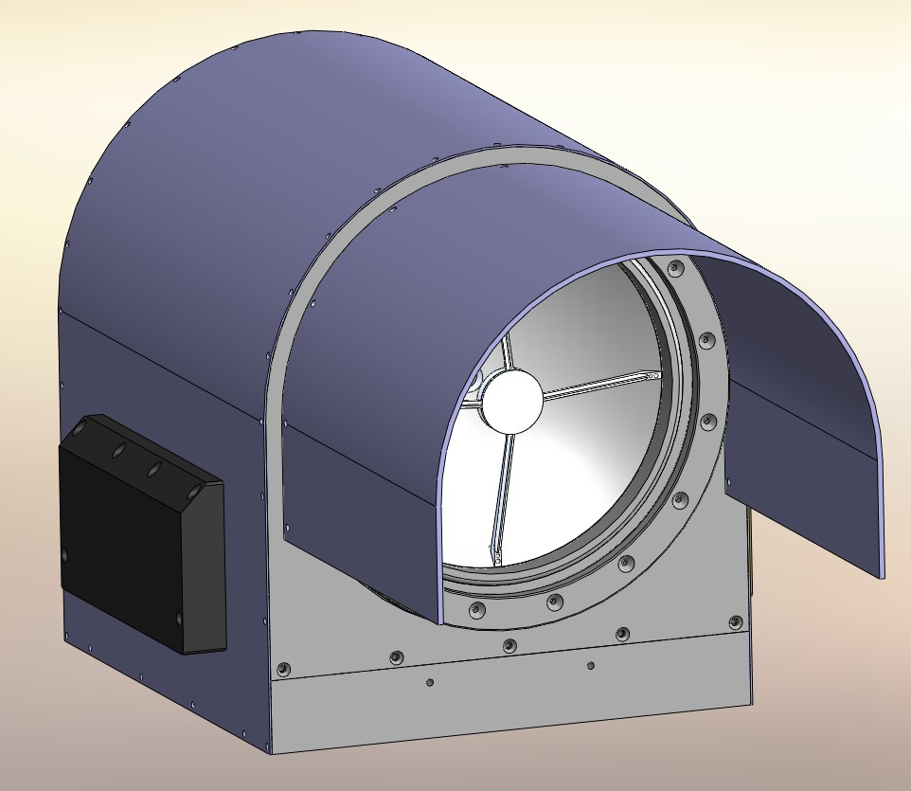
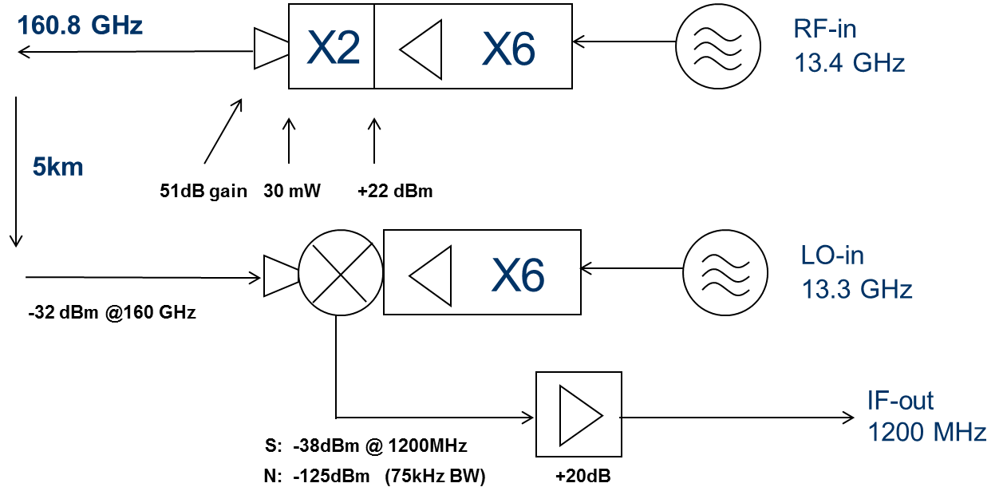
Scintillometer Design
Key features of the MWSC:
Frequency: 160.8 GHz (λ=1.86 mm) for small beam and sufficient co-spectrum with optical LAS
300 mm Cassegrain optics (51 dB gain)
40 mW transmitted power
Detection bandwidth: 10 kHz
Sensitivity of 90 dB

Slide 13
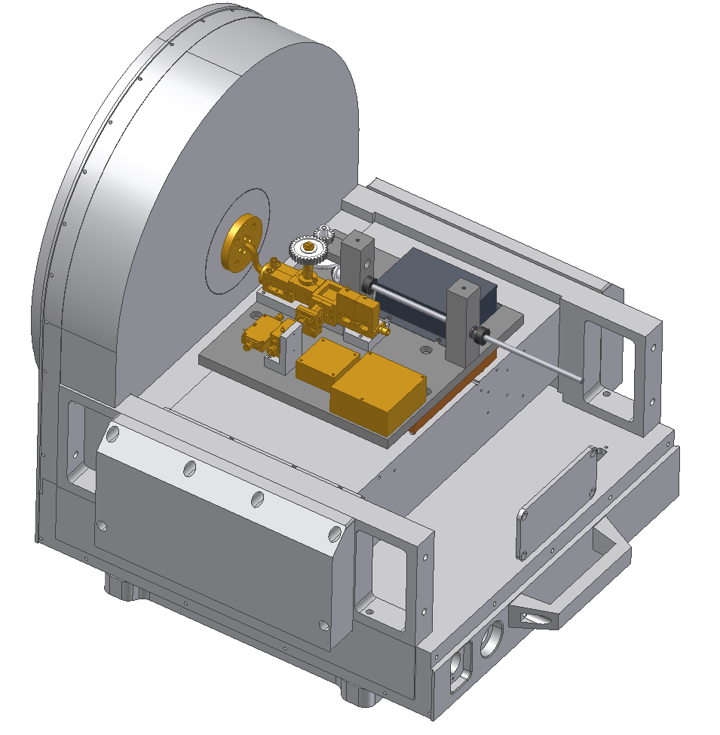
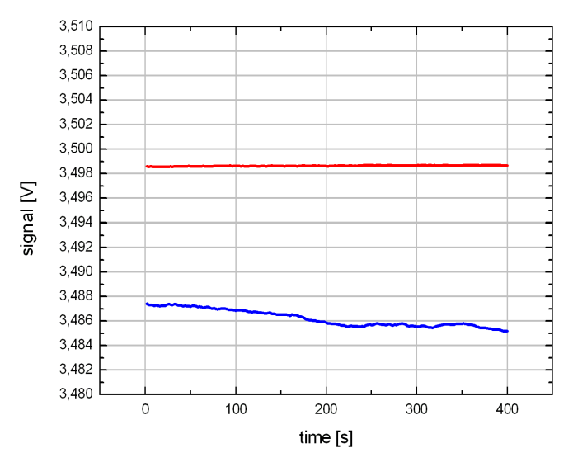
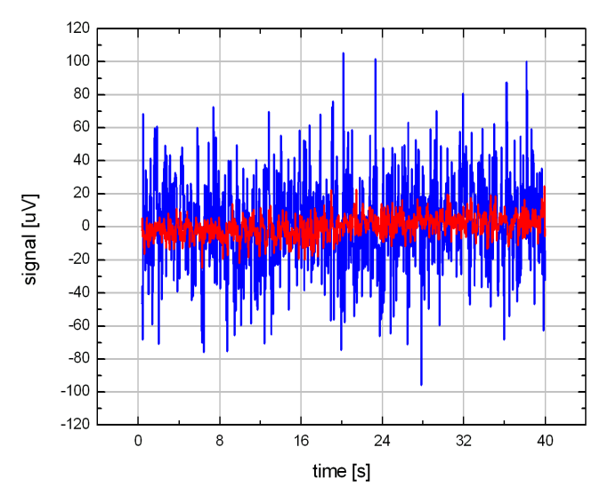
Scintillometer Technology
MWSC Technology Heritage:
Housing, power supply, T-control: Heritage from µ-wave radiometer
160 GHz source originally designed as 166 GHz source for MetOp-SG 664 LO
Receiver: Modified 150 GHz Space FE
Source stability (with AGC): 1.8 e-6
Ultra-stable frequency at Tx and Rx units
DC
AC

Slide 14
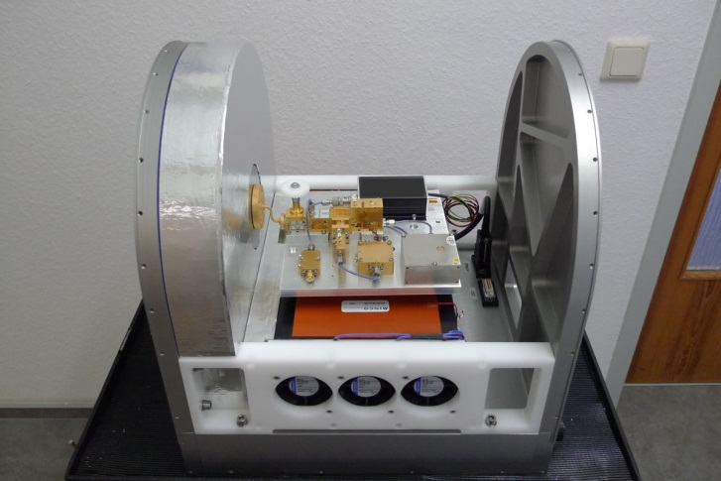
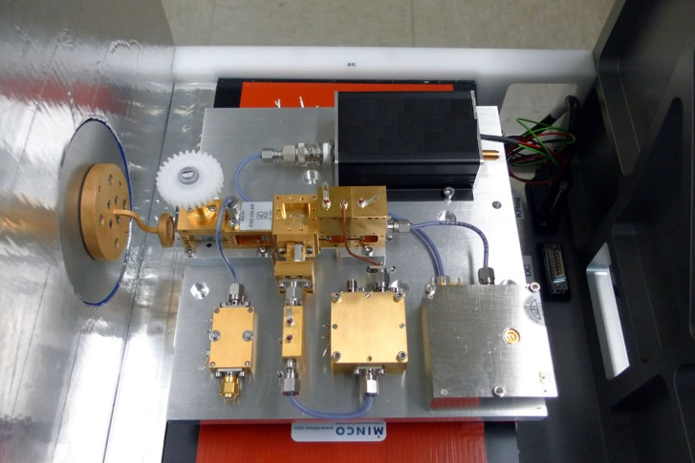
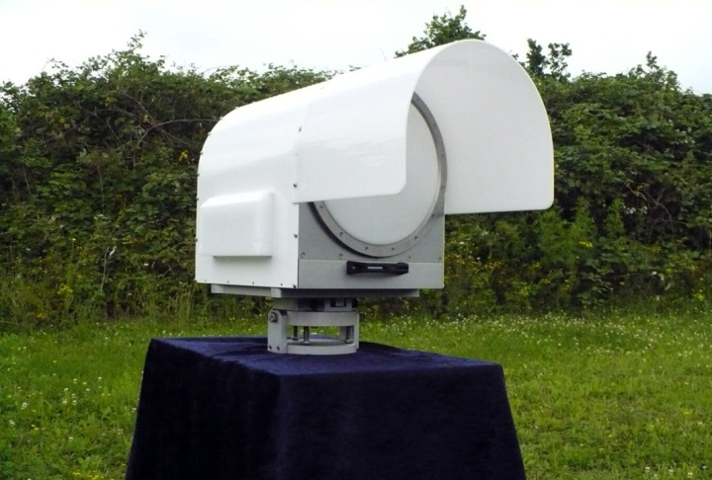
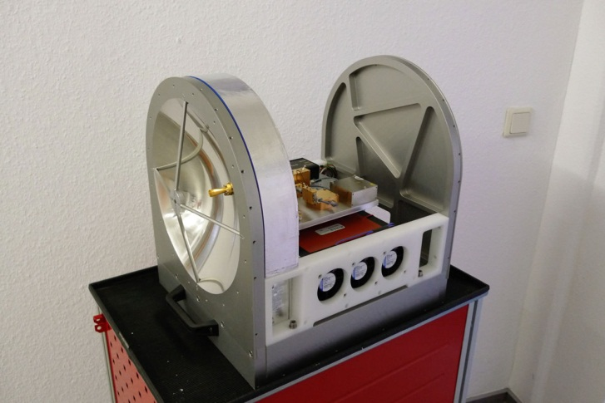
MWSC Integration: End of August 2012

Slide 15
MWSC Integration: End of August 2012

Slide 16
RPG-FMCW-94
RPG-FMCW-94-DP
A Cloud Radar by RPG
Frequency Modulated, Continuous Wave, 94 GHz
Low mode for fog, high mode up to 12 km
Re-using RPG technology from Tx/Rx systems and network analysis
Re-using instrument infrastructure (housing, steering, control, data processing) from microwave radiometers
Supported by Fraunhofer Institute for RF Technology and Radar (FhG-FHR, Wachtberg, Germany, formerly FGAN)
Availability: Mid of 2013

Slide 17
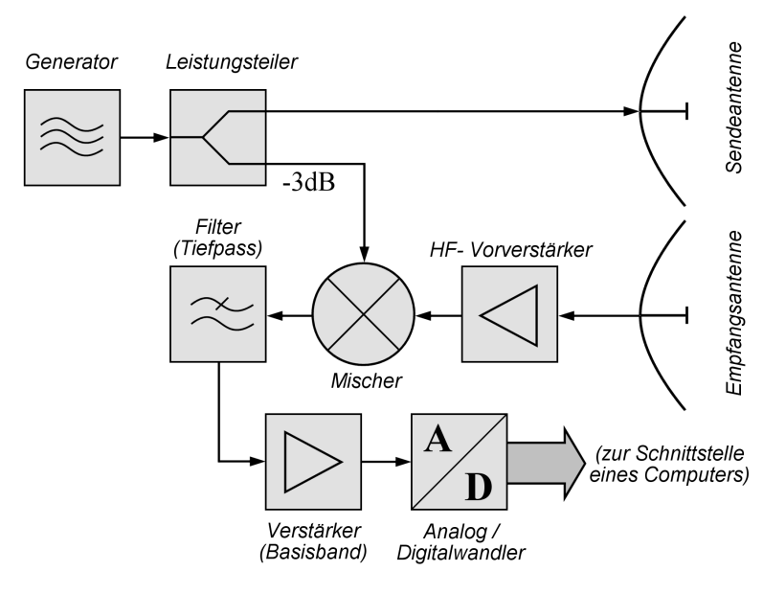
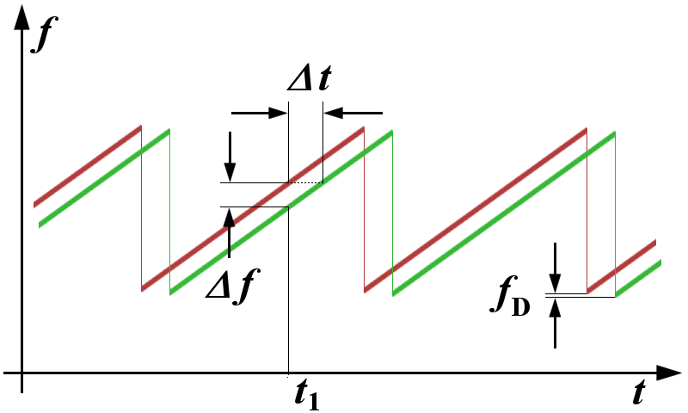
FMCW Radar Concept (in brief)
Distance to Object:
Altitude Resolution:
Velocity:
Radar Reflectivity:

Slide 18
RPG-FMCW-94 Specifications (I)
Operating Frequency: 94 GHz +/-150 MHz
IF Range: 0.5 MHz to 1.3 MHz
Continuous Power: 500 mW (Solid State)
T/R Type: Bi-static
Antenna Diameter: 500 mm
Gain: 52 dB
Chirp Rate: 100 / sec
Chirp Variations: 7
Passive LWP Channel: 89 Ghz (optional)
Dynamic Range: -100 dBz to +20 dBz

Slide 19
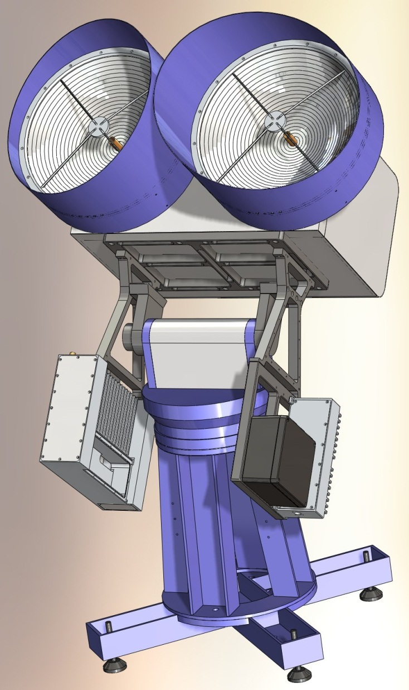
RPG-FMCW-94 Specifications (II)
Ranging: 10 m to 12 km
Sampling Rate: 1 / 4 seconds
Vertical Resolution: 1 m (r: 10m - 600 m)
2 m (r: 0.6 – 1.0 km)
4 m (r: 1.0 – 2.5 km)
8 m (r: 2.5 – 5.0 km)
16 m (r: 5.0 – 12.0 km)
Doppler Resolution: +/- 15 cm/sec
Polarisation: v / h (optional)
Availability: Mid of 2013
Possible extensions by
Additional frequencies
Passive microwave channels
Polarisation options

Slide 20
Summary / Conclusions
Microwave Radiometers
High-resolution boundary layer tenperature profiling possible with suitable/optimized receiver architecture
Optimization / synergy with space projects (60 GHz LNA, calibration concepts)
Scintillation
Transfer of known concept (optical LAS for sensoble heat flux) to microwave / millimeter wave region @160 GHz
FMCW cloud radar
Transfer of existing Tx/Rx technology from Lab to field
Rapid Prototyping and reduced time to market only possible due to broad field of applications at RPG.

Slide 21
Thank you!
czekala@radiometer-physics.de

