Slide 1

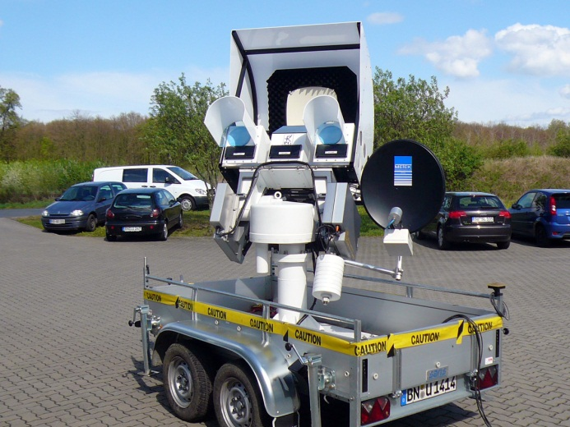
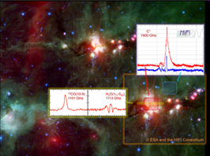
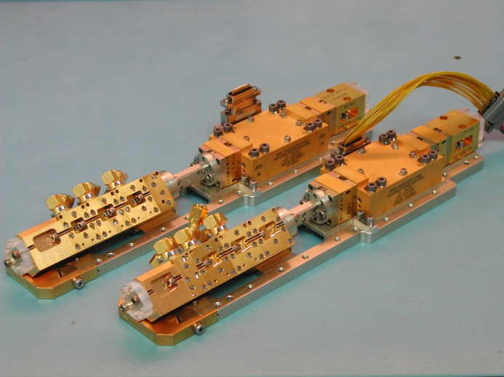
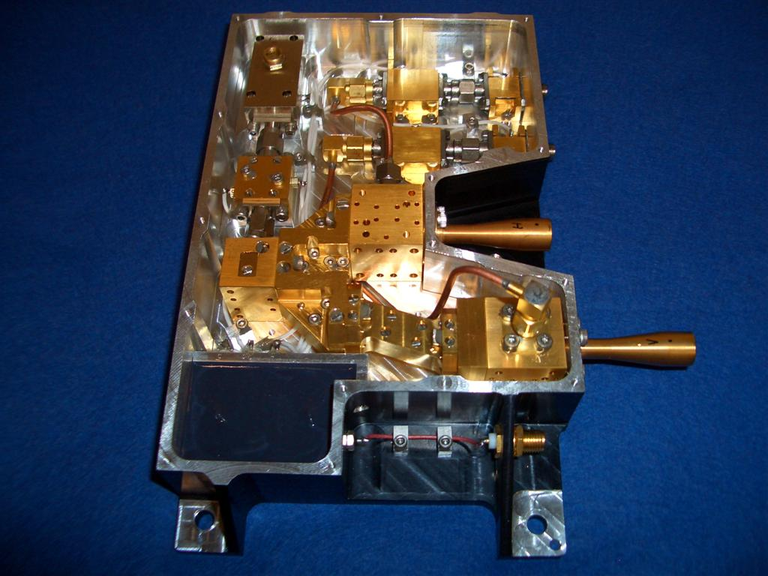
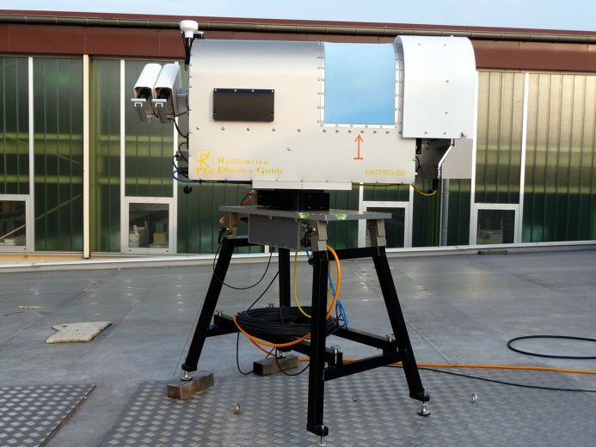
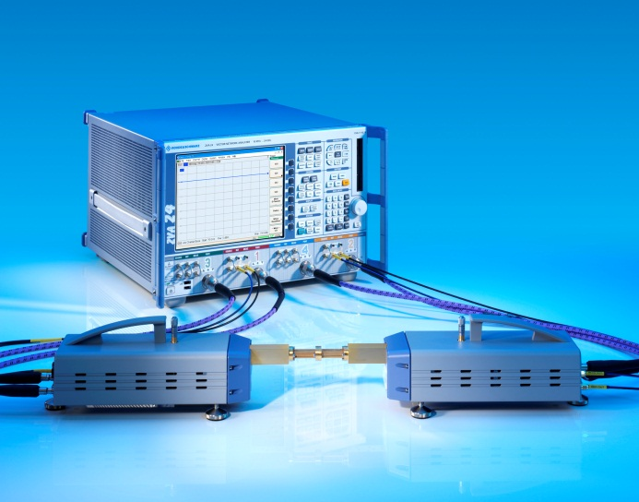
Radiometer Physics GmbH
Meckenheim, Germany
Microwave, sub-mm, THz
Turn-key radiometers, space technology Components, design, scientific expertise

Slide 2
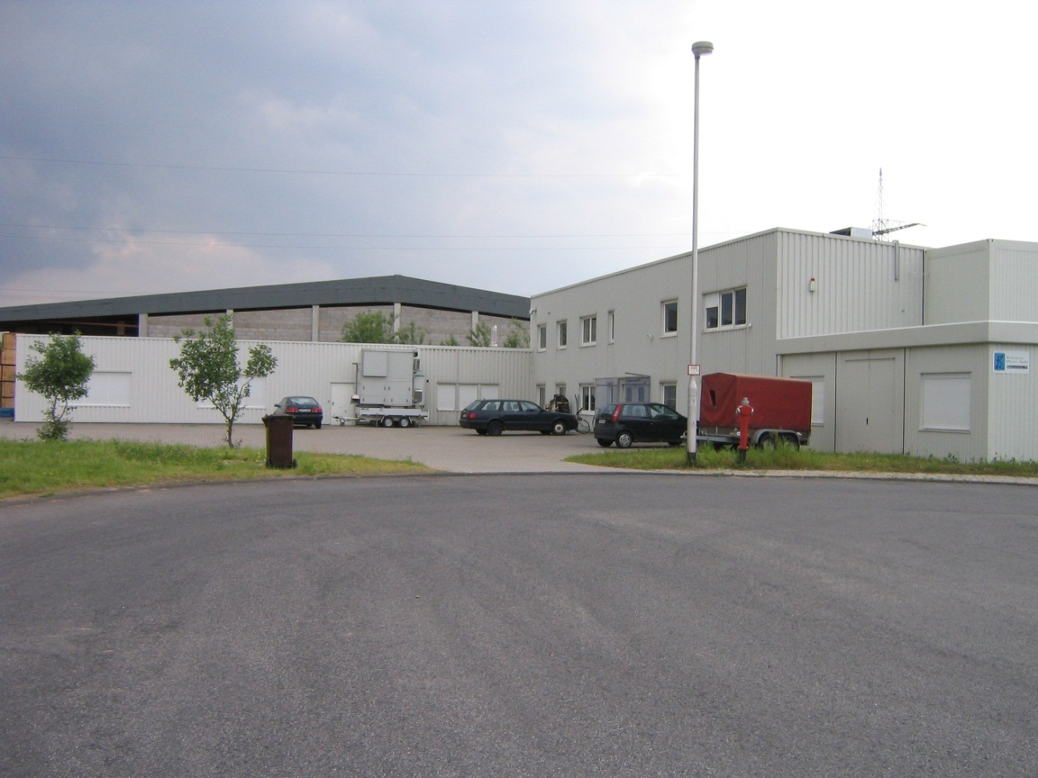
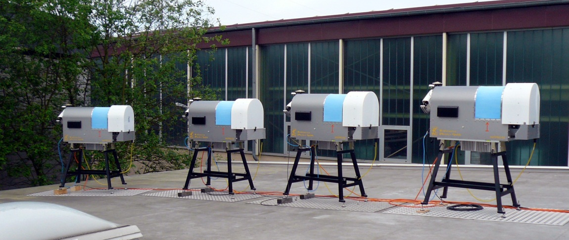
Radiometer Physics GmbH
Founded 1973 by Dr. P. Zimmermann
40 (+) employees
Design / fabrication of
MW-radiometers (mm, sub-mm)
Development of radiometer sub-
systems (oscillators, mixers,
waveguide components, planar
networks, amplifiers, optics, etc.)
Active in the following fields:
Radio Astronomy
Plasma Physics
ESR Spectroscopy
Remote Sensing
Space borne radiometers
Network Analyzer Extensions

Slide 3
RPG GmbH Organization
Company Management
Managing Board
M. Lüders (R&S), Ch. Evers (R&S), Dr. T. Rose (RPG), A. Walber (RPG)
Managing Directors
Dr. T. Rose, A. Walber
Sales & Marketing
Dr. H. Czekala,
R. Henneberger
Business Development
Dr. H. Czekala, A. Walber,
R. Henneberger, Dr. T. Rose
Financials & Management Assistant
K. Ley
Business Divisions
Rohde & Schwarz OEM RF Systems & Comp.
A. Walber, J. Oelrichs
Radiometer Systems
Dr. T. Rose, A. Mombauer,
Dr. H. Czekala
R&D Projects
R. Henneberger,
Dr. M. Brandt, Dr. M. Philipp,
Dr. B. Thomas
FFTS Systems
R. Henneberger
Space Projects
Dr. M. Brandt, Dr. M. Philipp
R. Henneberger,
Dr. H. Czekala
Operations & Activities
Design, Development & Analysis
Component and System Development
RF Component & Optics Simulations
(CST, HFFS, ADS etc.)
Space Environment
Simulation & Analysis
Meteorological Concepts & Retrievals
Scientific Consultancy
Software Development
Manufacture & Integration
Machine Shop
Electroforming Facilities
Clean Room MMIC Assembly
RF Component Manufacturing
R&S OEM Products Integration
Meteorological Radiometer Integration
Clean Room Space Product Integration
PA/QA, Test & Verification
Manufacturing Process Control
Semi-Automated ICD Verification
RF Performance Testing
RF Calibration
Antenna Pattern Measurements
R&S High-Rel BI & Thermal Cycle
Environmental Testing

Slide 4
Fields of activity (2010)
20% (+)
Meteorological
Remote Sensing
Umsatz RPG: 5.300.000€

Slide 5
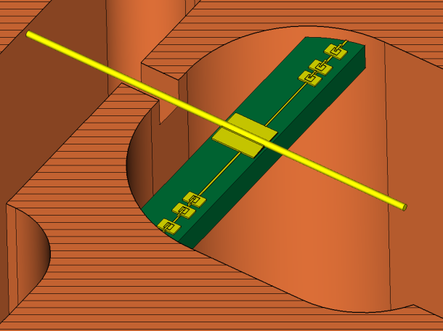
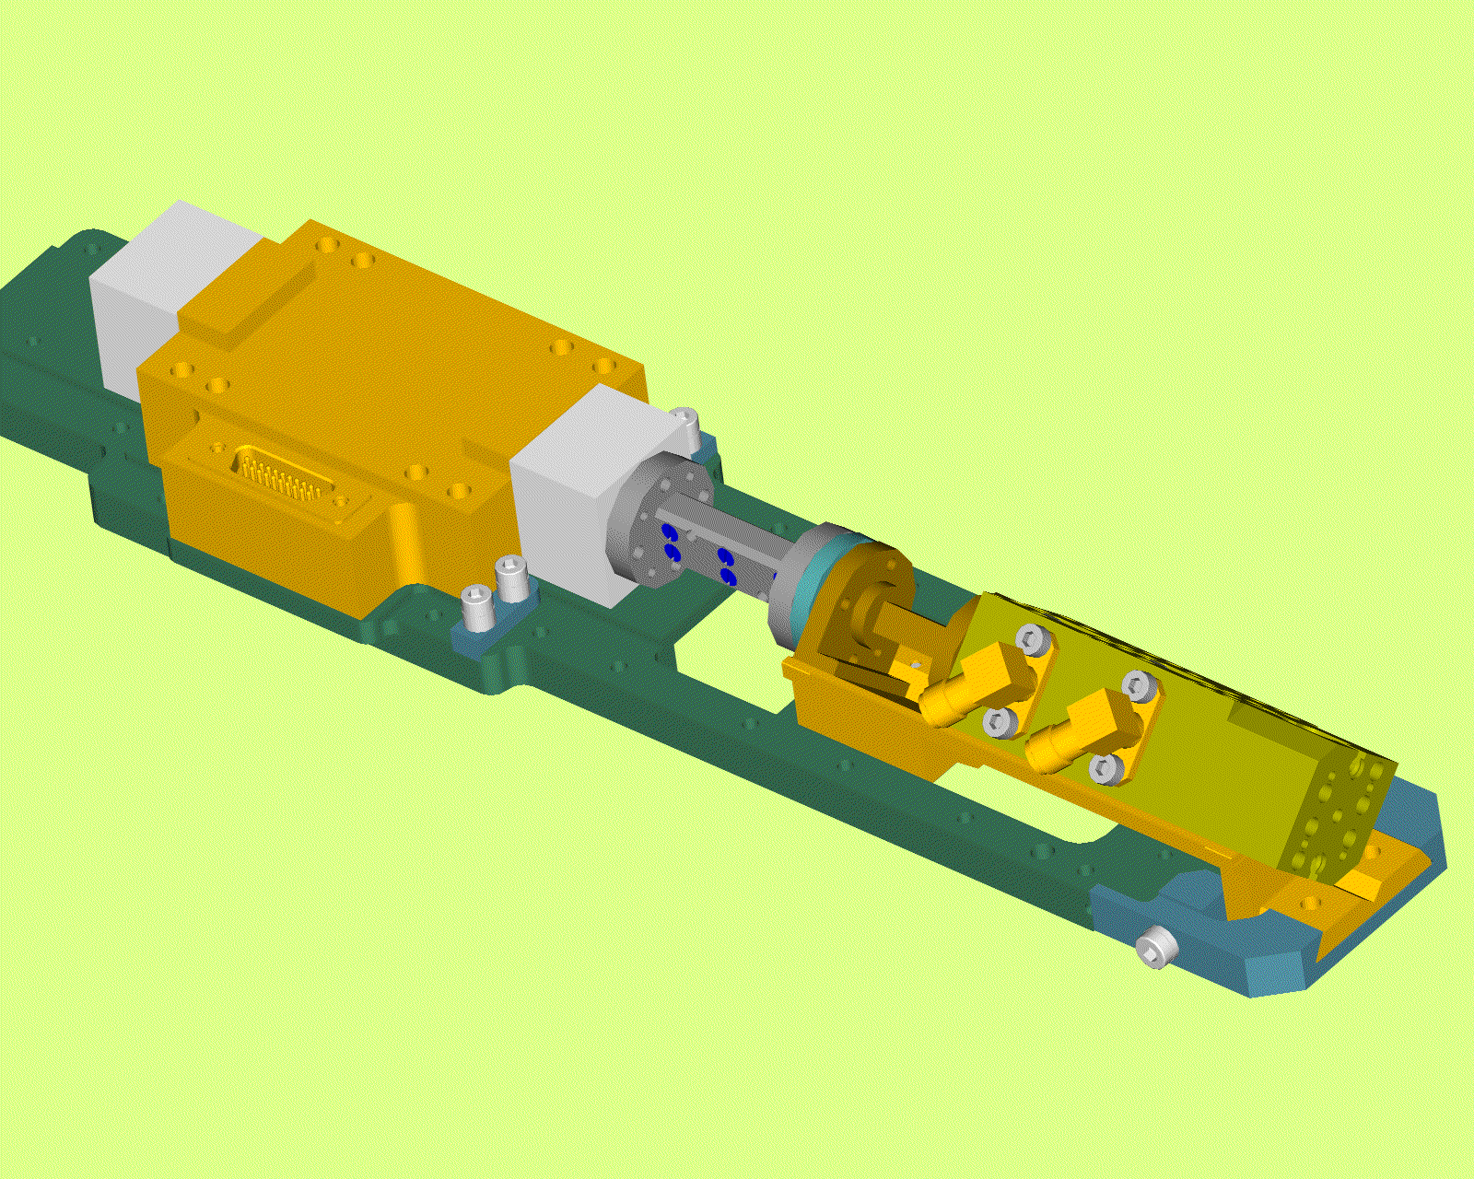
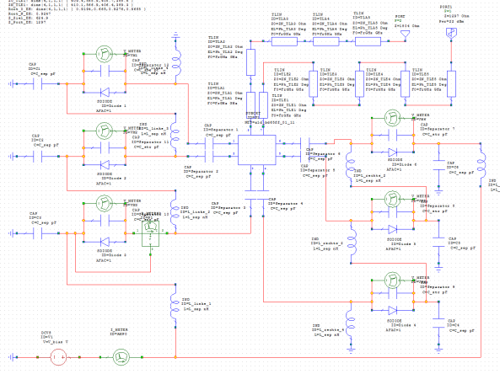
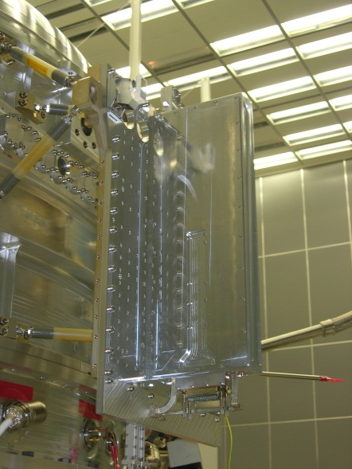
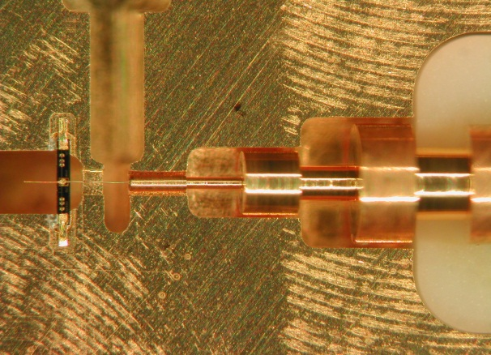

Technology to Product
Harmonic Balance
Electrical Solvers
Electromagnetic
Simulation
Engineering
CAD → CNC
Knowledge, experience, precision and quality
Design
Development
Manufacture
Integration and Test
Machining +
Integration
Local Oscillator
Subsystem
FIRST/HIFI Instrument
on Herschel Satellite

Slide 6
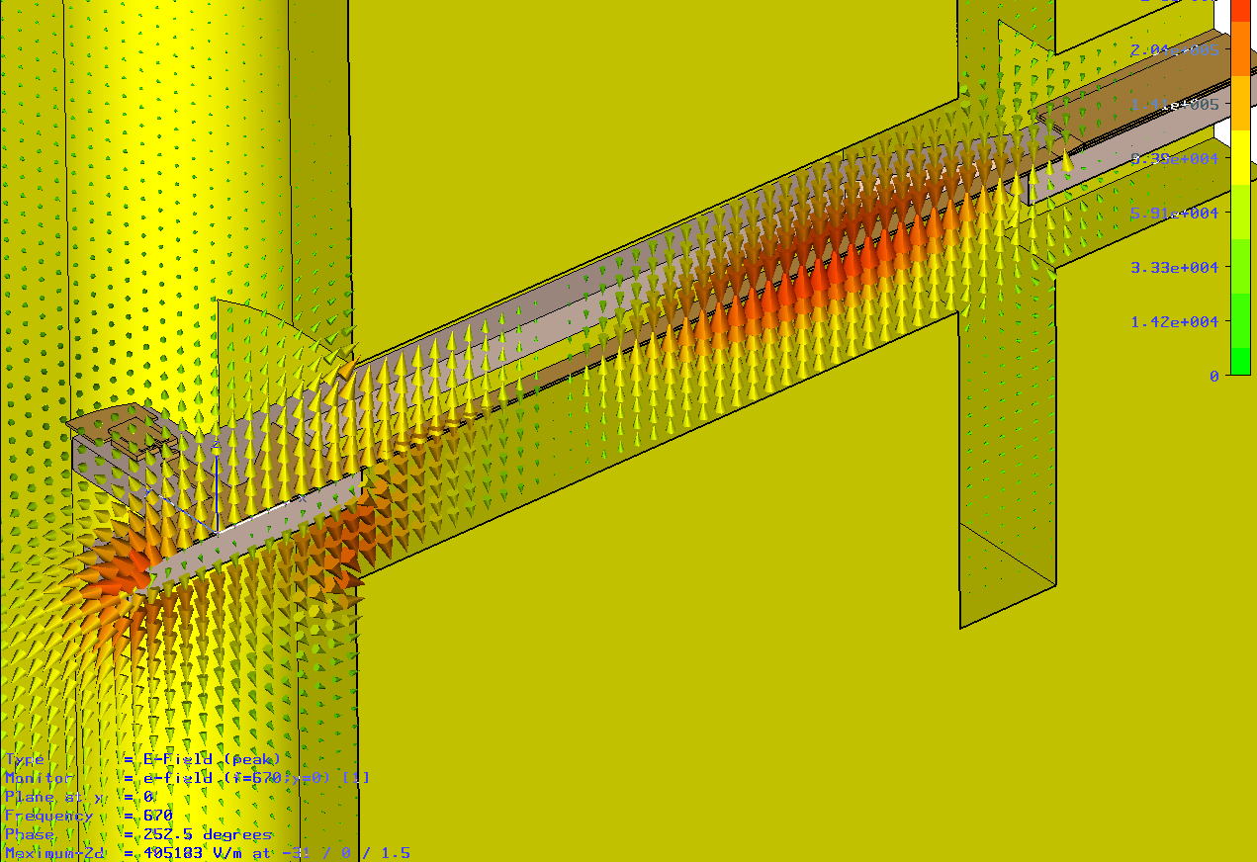


Simulation and Design Capabilities
CST Suite:
3D structure simulator
(filters, circulators, …)
Microwave Office:
Harmonic Balance Analysis
(mixers, multipliers)

Slide 7
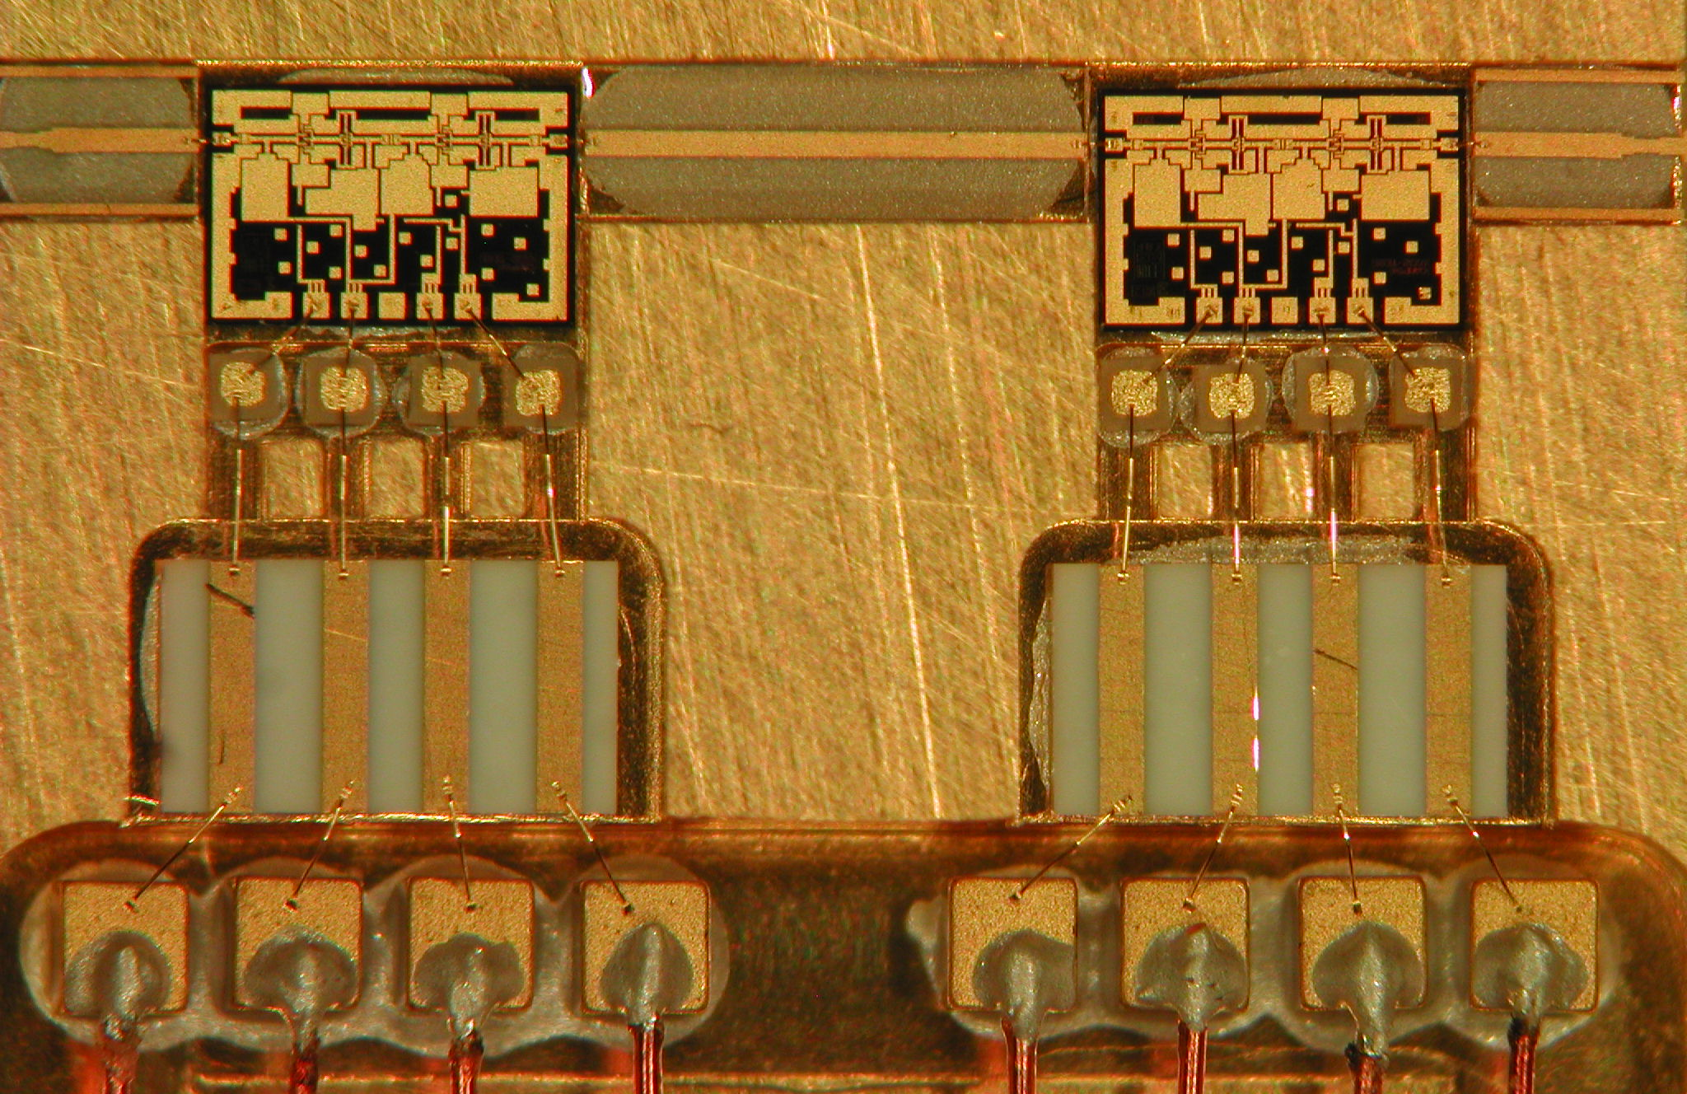
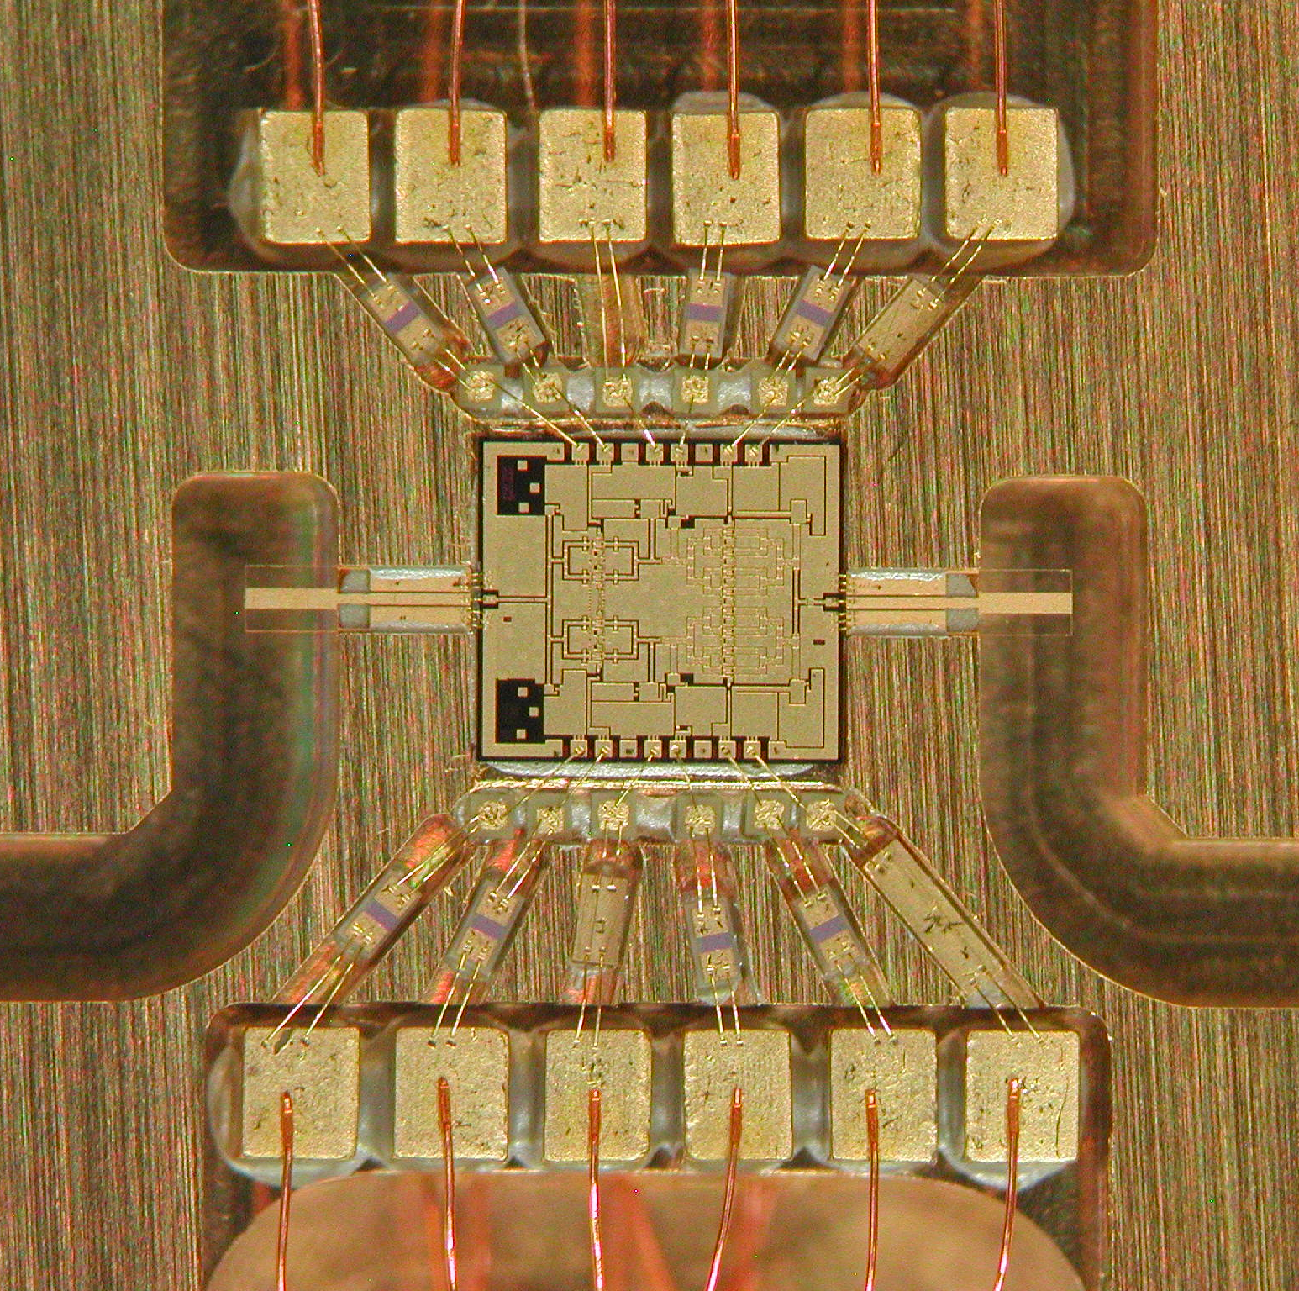
Amplifier bonding (clean room, space standards)
Mounting of all amplifier types
Experience in micromachining
Bonding and soldering to space standards

Slide 8
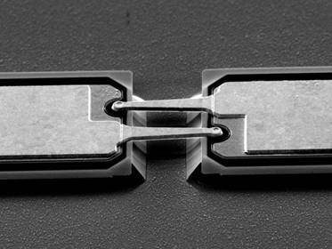
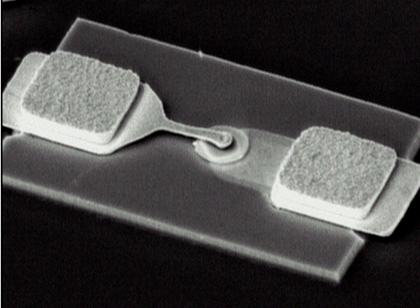
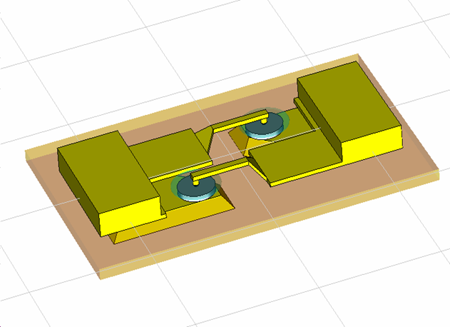
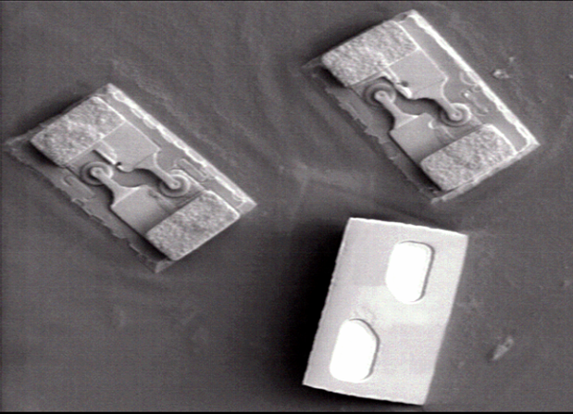
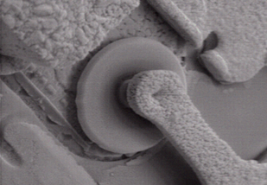
Schottky Mixer and Multiplier Improvements
Planar technology
Discrete Schottky devices
Semi-integrated and full integrated structures
Two collaborations:
STFC/RAL, UK
ACST, Germany
Mandatory improvements
for 800 to 1000 GHz
circuit mountings:
Reduced C_{j0}
Reduced C_{str}
Smaller size
ESTEC Contract 22032/08/NL/JA: Sub-Millimeter Wave Receiver Front-End (at 664 GHz)
ESTEC Contract 21628/08/NL/GLC: Integrated Schottky Structures (at 664 GHz)
RAL Diode
Air-bridge
Anode pillar
(contact pad)
ACST Diode
Membrane-
substrate
Mesa with
anode
Quasi-vertical (QVD)
single Diode (SD)
Cathode pillar
(contact pad)
Back-side ohmic
25μm
Air-bridges
Mesas
Membrane-
substrate
Anti-parallel (APD) diode
Protection pillars
(contact pads)
Back-side ohmic
50μm

Slide 9
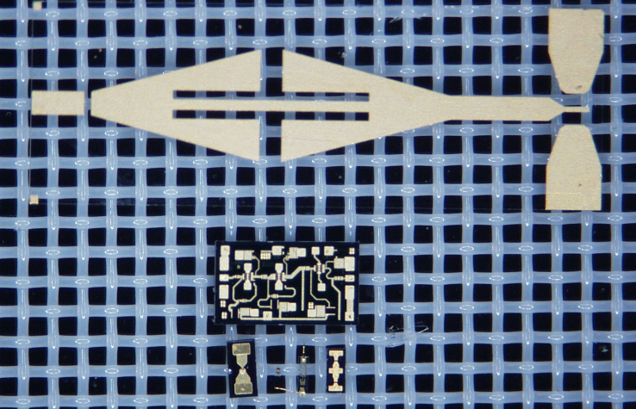
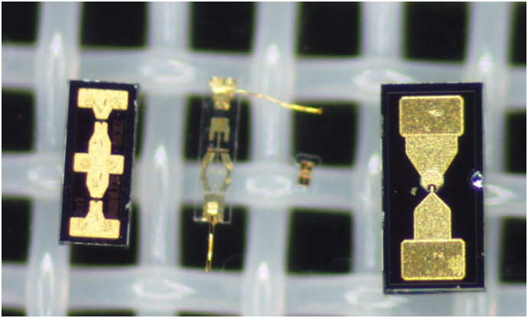
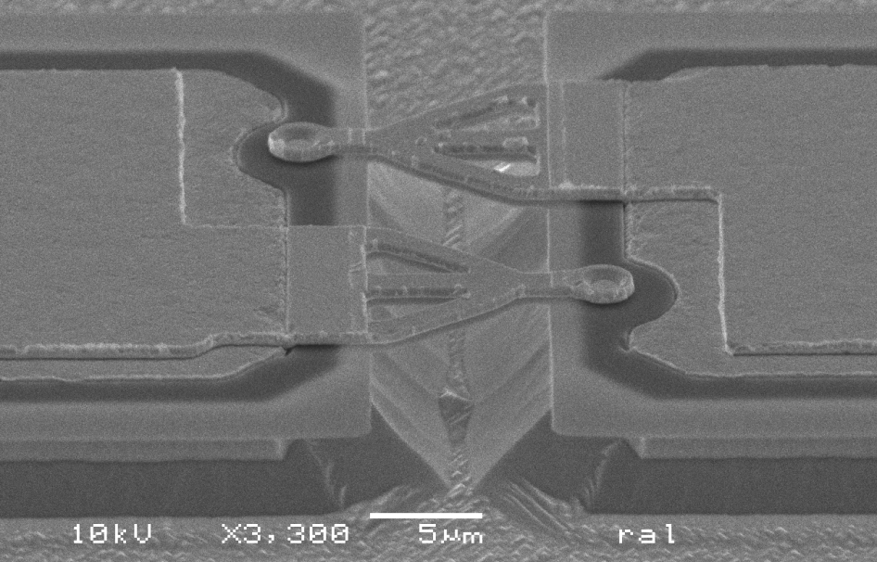
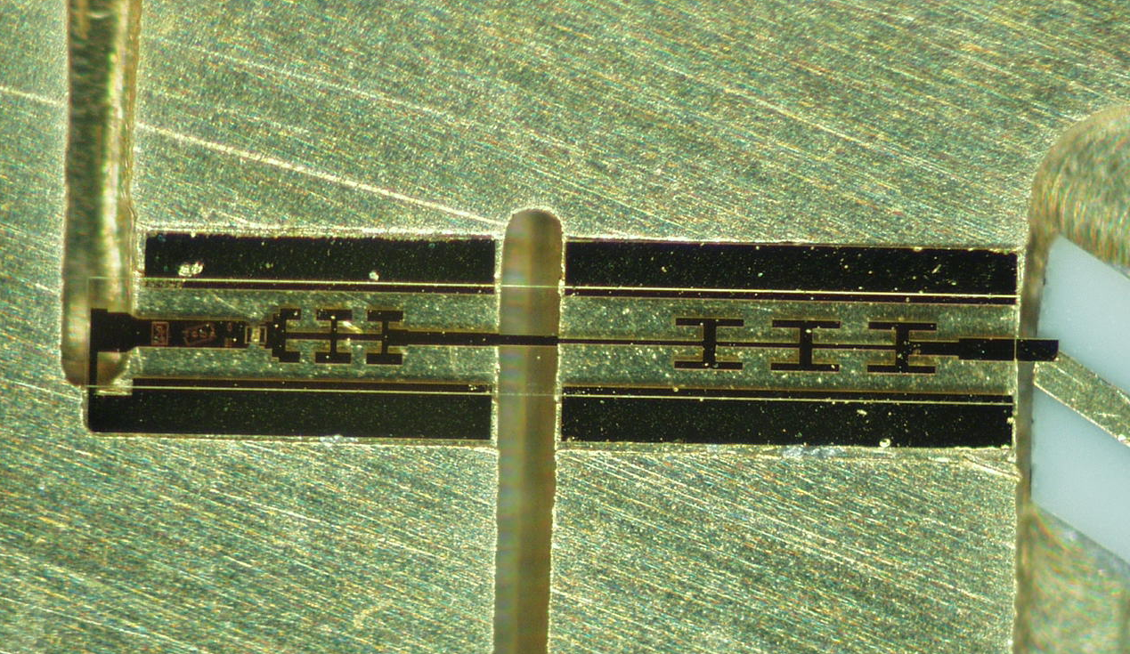
Sample pictures
UMS
ACST
Diode
UMS MMIC
50-100 GHz
ACST/RAL
300-664 GHz
900GHz Substrate
Integrated SHM 664 GHz
RAL APD

Slide 10
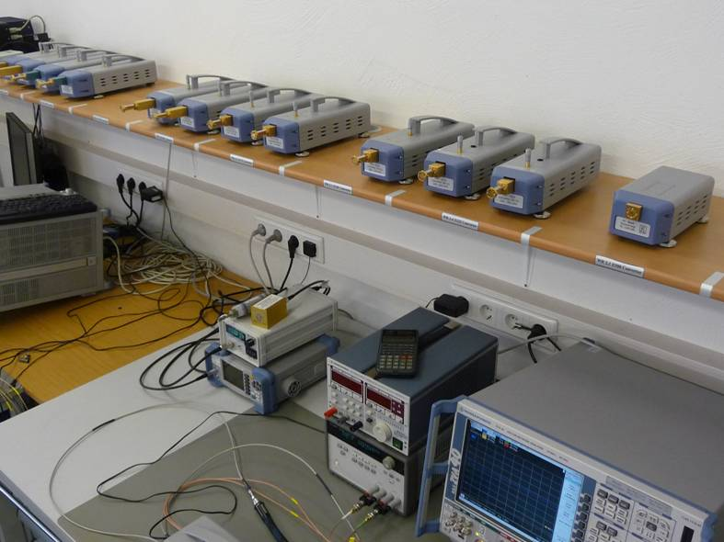

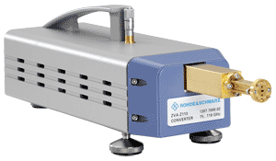
Improved Schottky Diodes: VNA Extender
50 – 75 GHz
60 – 90 GHz
75 – 110 GHz
90 – 140 GHz
110 – 170 GHz
140 – 220 GHz
220 – 325 GHz 325 – 500 GHz
(500 – 750 GHz)
OEM
Network Analyzer Frequency Extenders
for
Rohde & Schwarz
Courtesy of Rohde & Schwarz

Slide 11
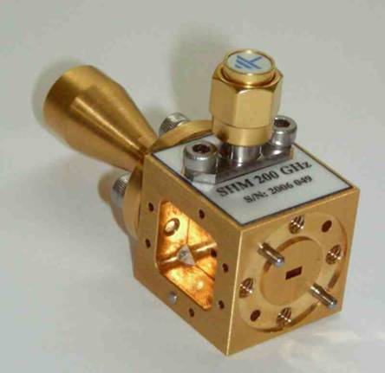
Improved Diodes: RPG sub-harmonic mixers
Art.-No. | RF Range [GHz] | DSB-Noise Temperature | Conversion Gain (DSB) | IF-Band- width | Required LO Power | Waveguide LO RF
SHM118 | 104-132 | 500 K | -5 dB | > 16GHz | 6 dBm | WR15 | WR8
SHM137 | 110-165 | 500 K | -6 dB | > 20 GHz | 4-7 dBm | WR12 | WR6.5
SHM150 | 134-167 | 450 K | -6 dB | > 16 GHz | 2 dBm | WR12 | WR6.5
SHM183 | 167-200 | 430 K | -4 / -5 dB | > 16 GHz | 4 dBm | WR10 | WR5.1
SHM220 | 185-230 | 500 K | -6 dB | > 18 GHz | 4-7 dBm | WR10 | WR5.1
SHM280 | 265-295 | 700 K | -7 dB | > 18 GHz | 4-7 dBm | WR6.5 | WR3.4
SHM300 | 275-330 | 900 K | -7 dB | > 18 GHz | 4-7 dBm | WR6.5 | WR3.4
SHM340 | 310-360 | 1000 K | -6 / -7 dB | > 16 GHz | 4-7 dBm | WR6.5 | WR2.8
SHM424 | 400-440 | 1100 K | -7/ -8 dB | > 16 GHz | 7 dBm | WR4.3 | WR2.2
SHM664 | 644-680 | 1600 K | -8 dB | > 16 GHz | 4-7 dBm | WR3.4 | WR1.5

Slide 12
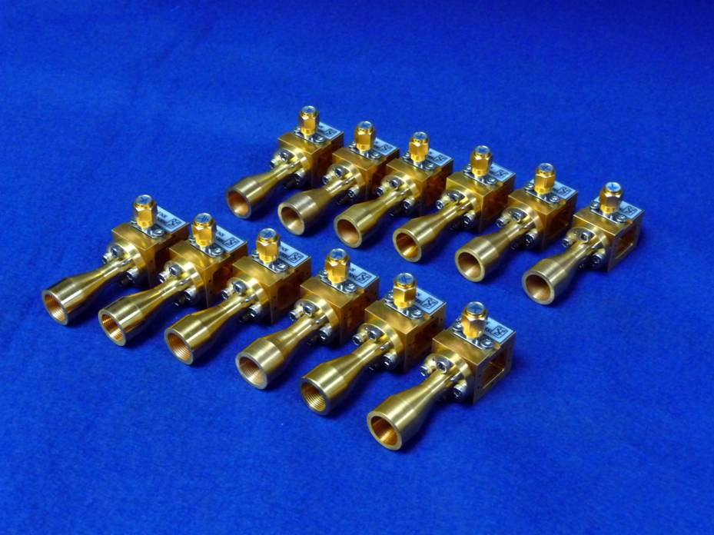
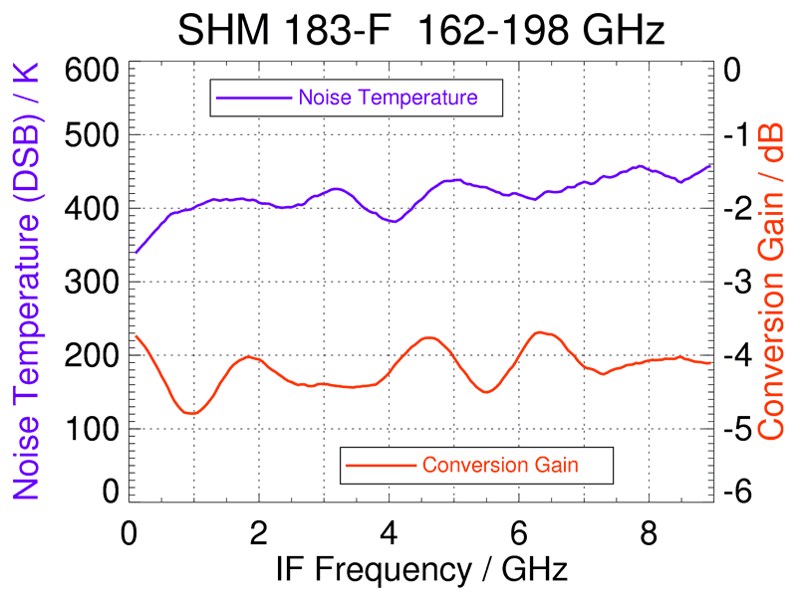
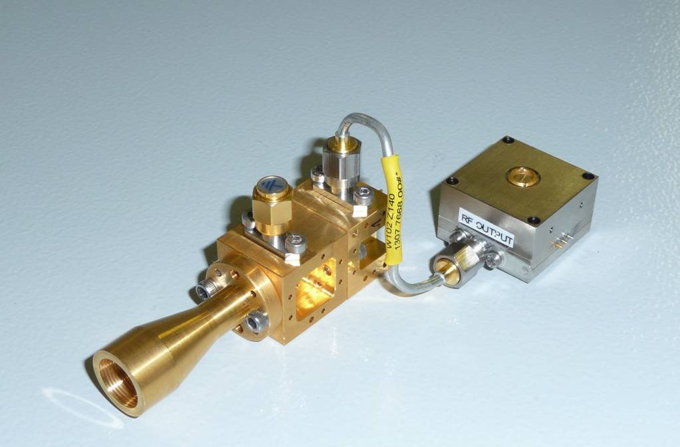
Receiver technology – 183 GHz example
183 GHz feeds and sub-harmonic
mixers for ALMA-WVR
Best 183 GHz receivers available
Built in larger numbers
Noise-injection calibration @183
(RPG only manufacturer world wide)
All ALMA water vapor radiometers equipped with RPG mixers and feeds

Slide 13
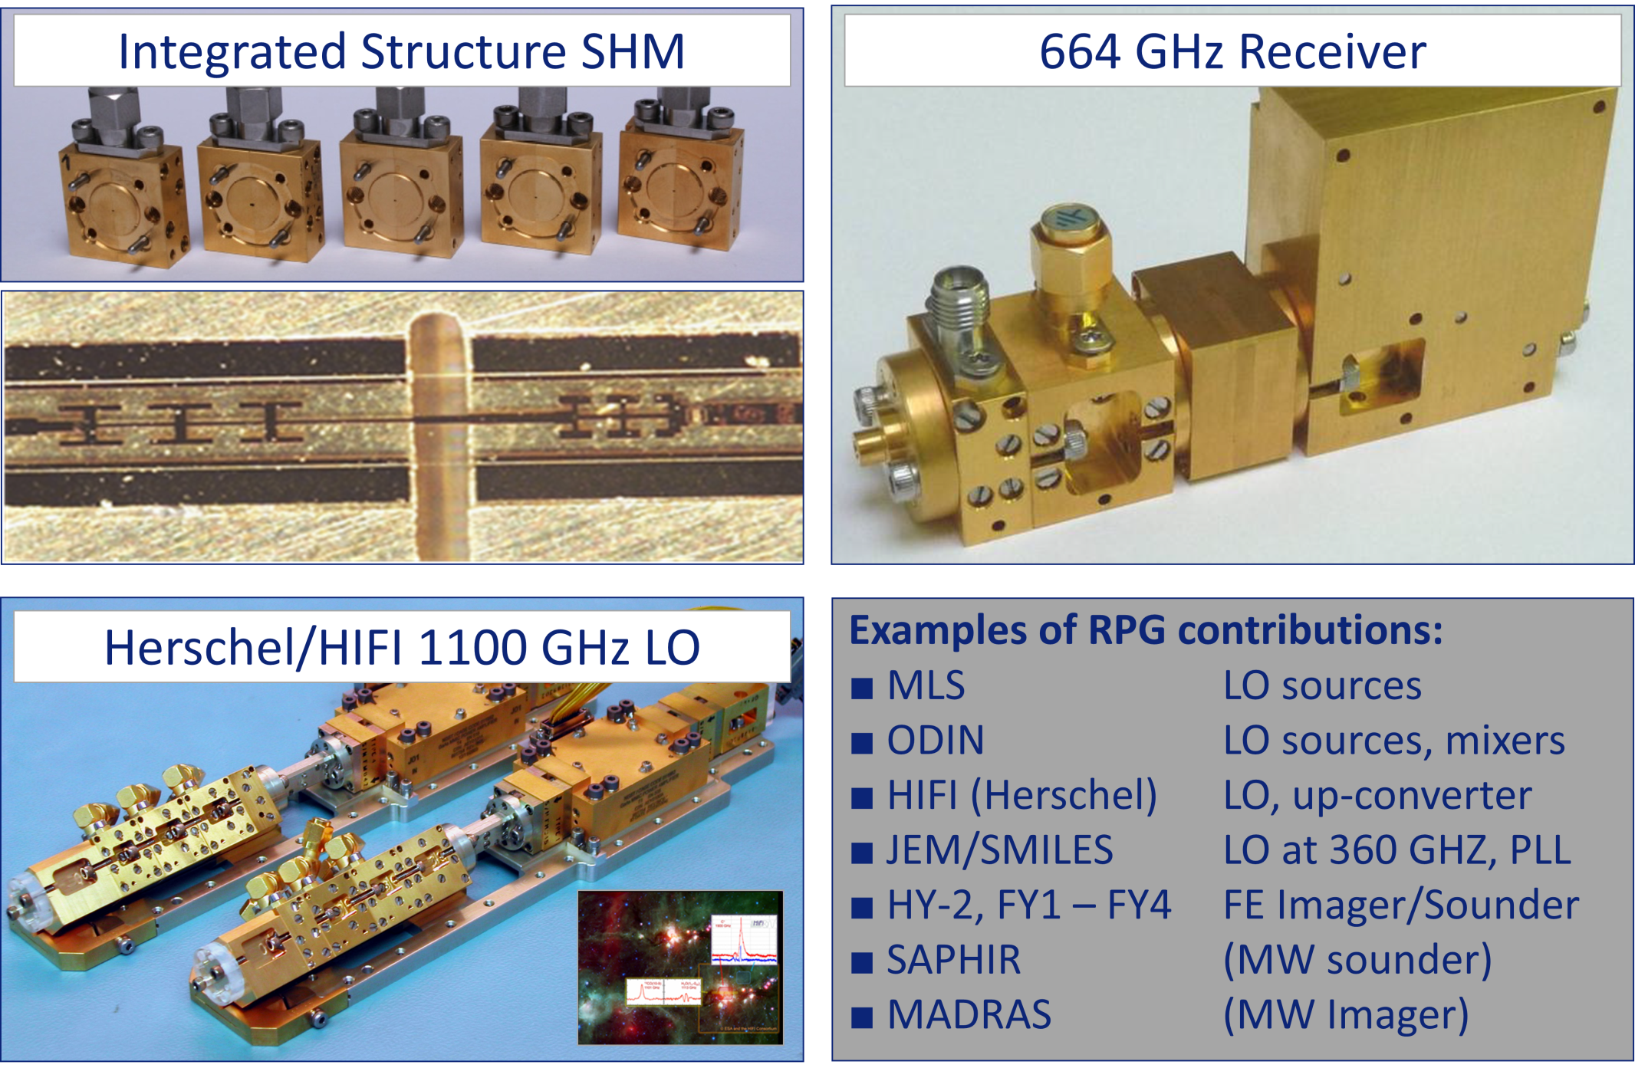
Space Products

Slide 14
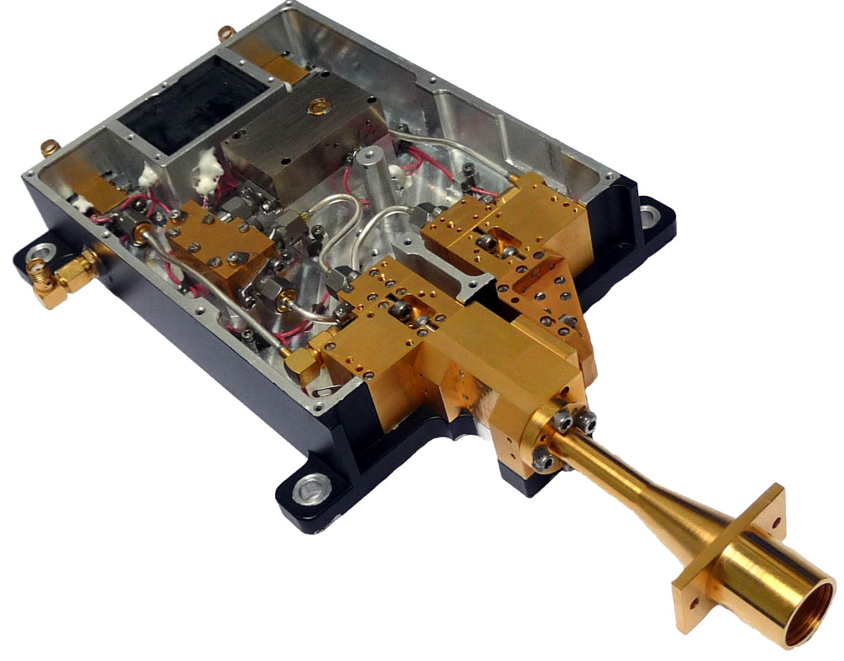
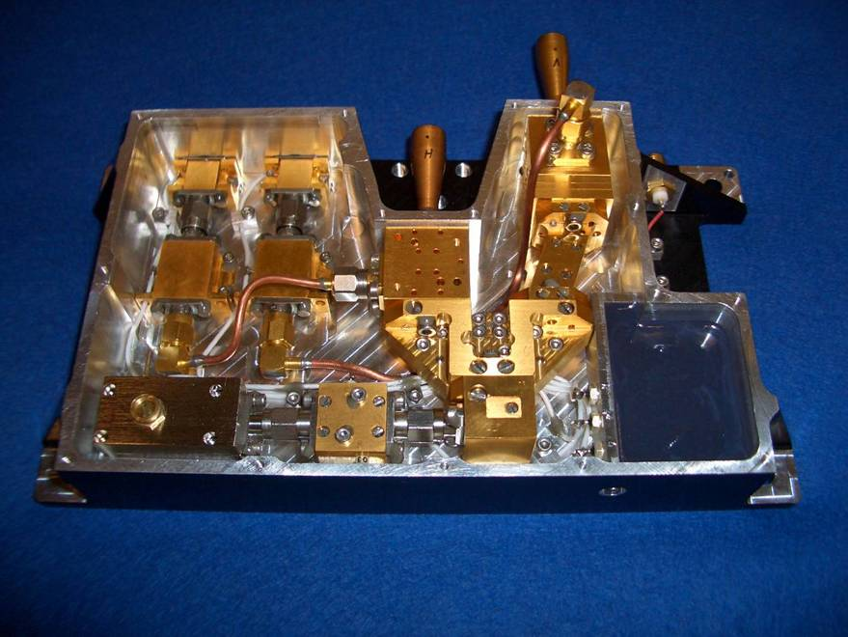
Space Products (II)
Space qualified front ends (China, FY-3):
90 GHz dual polarized receiver
OMT + LNA + (either Direct Detection or Heterodyne)
150 GHz dual polarized receiver: OMT + SHM

Slide 15
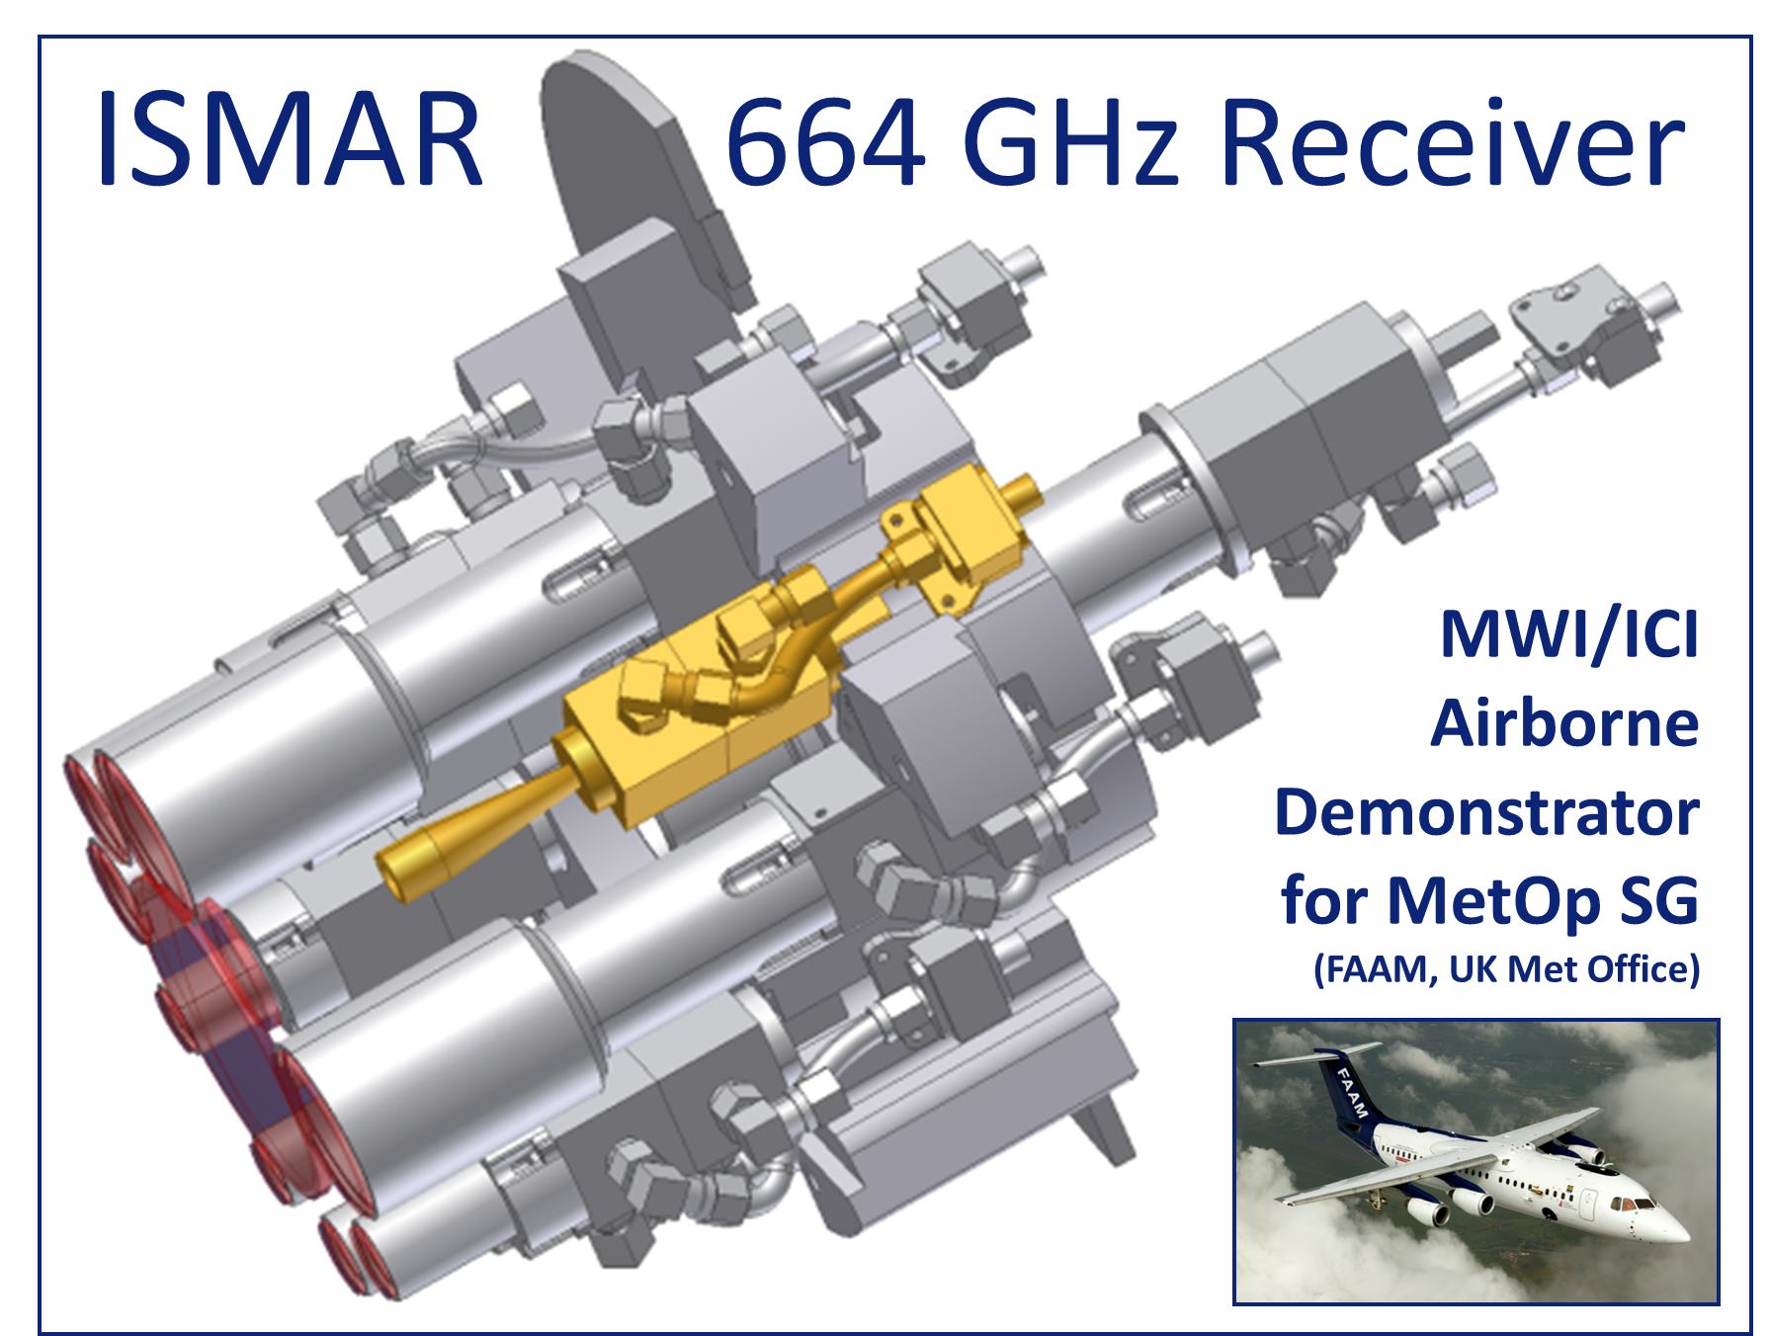
Preparations for MetOp-SG Ice Cloud Imager

Slide 16




Space Products (III)
Space qualified front ends:
183 GHz (4 channels) for sensitive water vapour detection
90 GHz dual polarized receiver
150 GHz dual polarized receiver

Slide 17
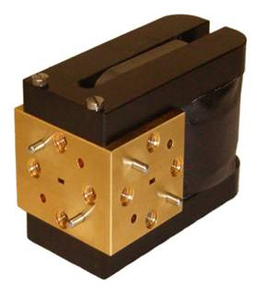
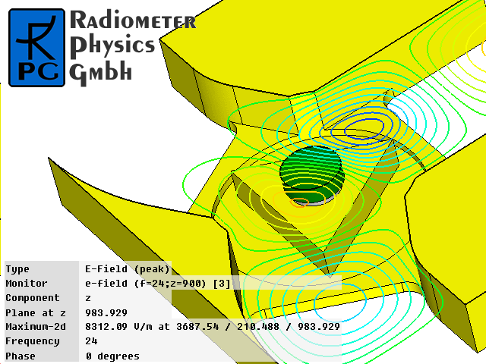
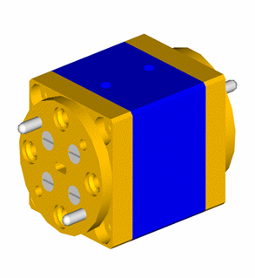
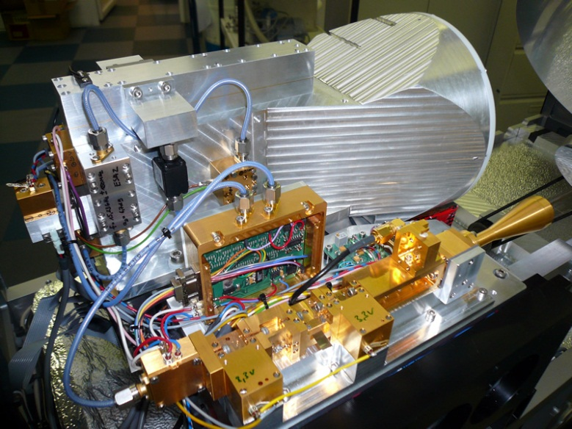
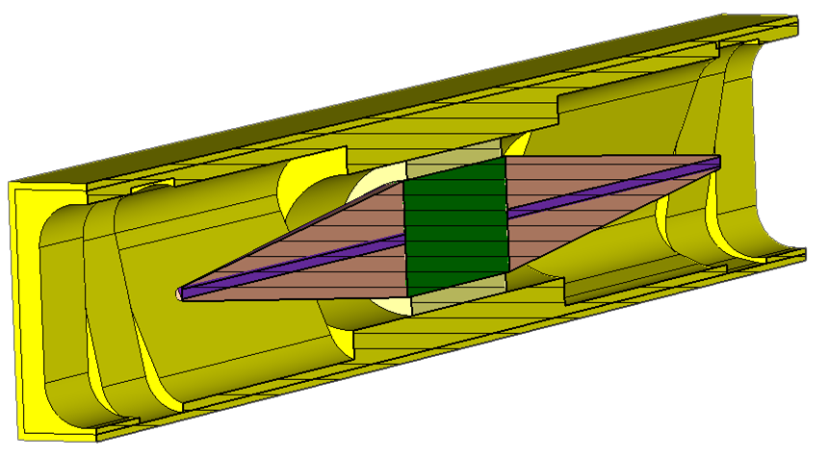
Auto-Calibration Receivers
Noise injection calibration up to 200 GHz
  7.000 K signal at 183 GHz with stable noise diode (15 dB ENR)
Magnetically switched isolators:
Dicke switching up to 150 GHz with low insertion loss (≤1.0 dB)
  Fast switching with low currents (small thermal effects, 100 mA, 0.5 V)
Allan Variance Stability: 4.000 s
Less dependent on external calibration
targets (LN2)!
ESA-ATPROP 15 / 90 GHz
17

Slide 18
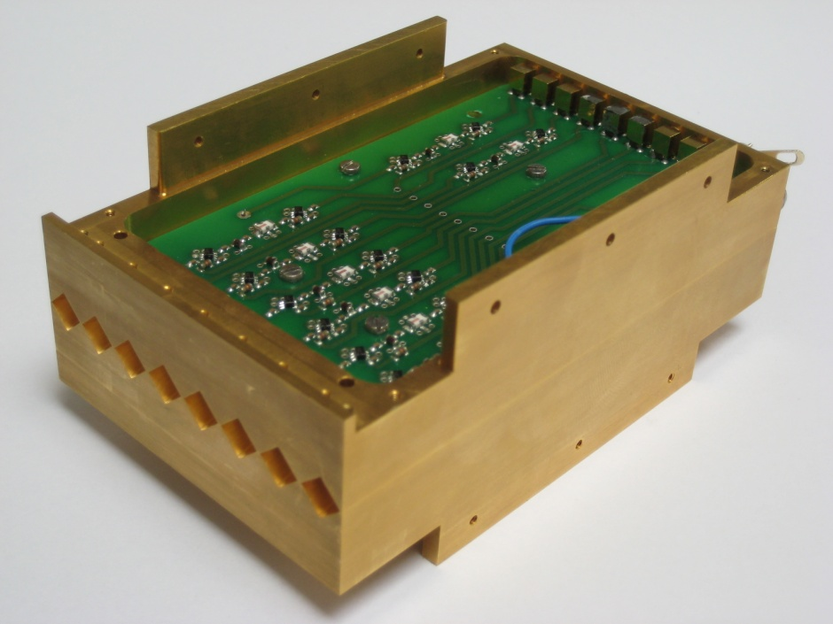
Sub-mm imaging receivers
One-Pixel and
Multipixel Receiver:
FMCW Radar 75 to 325 GHz
CW Radar
8-Pixel Array 230-320 GHz (ESA) and 8-Pixel Array 812 GHz,
4-Pixel Array 183 GHz
Imaging, Security, Material Analysis, Science

Slide 19
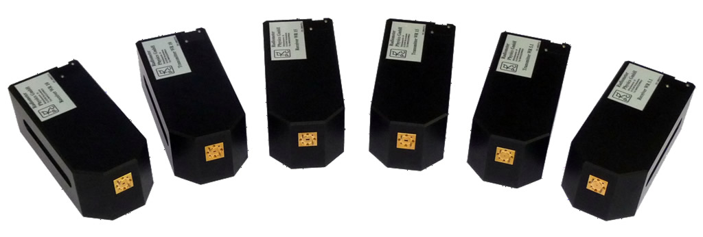
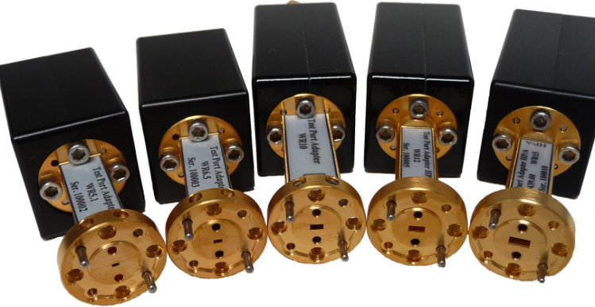
Antenna Measurement Solutions
Transmit / Receive Systems, Spectrum Analyzer Solutions:
Full-band
50-75 GHz 60-90 GHz 75-110 GHz 110-170 GHz 140-220 GHz 170-260 GHz 220-325 GHz 260-400 GHz 325-500 GHz
High Dynamic Receivers available at
90 GHz 183 GHz 220 GHz 324 GHz
502 GHz 640 GHz
For compact ranges (antenna measurement facilities, phase + amplitude)

Slide 20
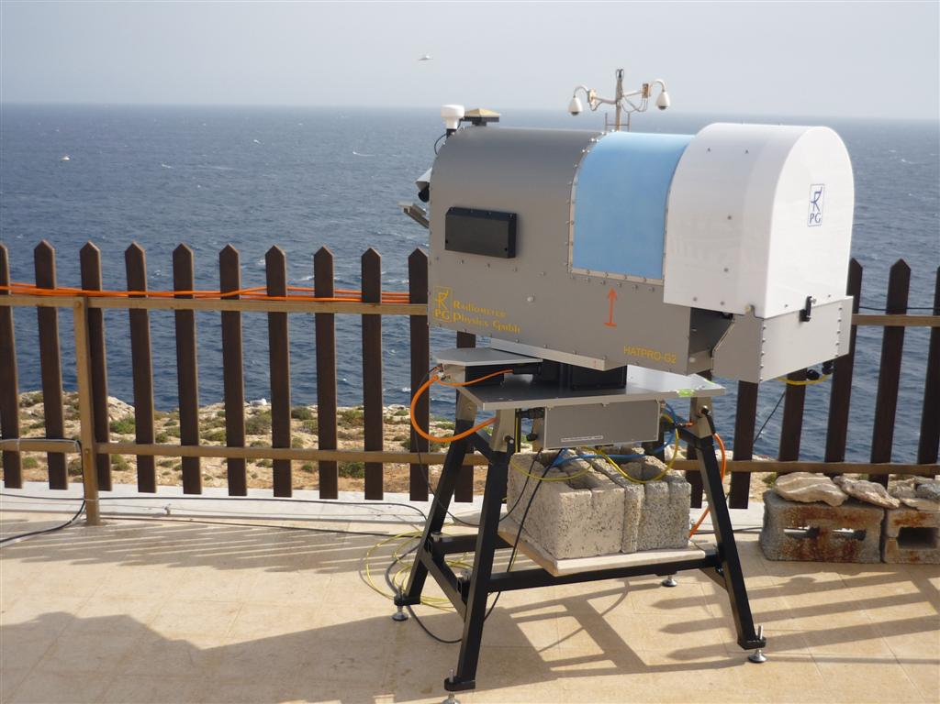
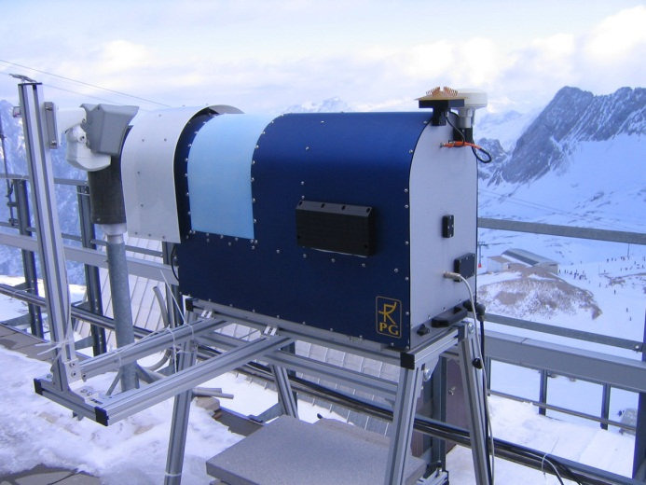
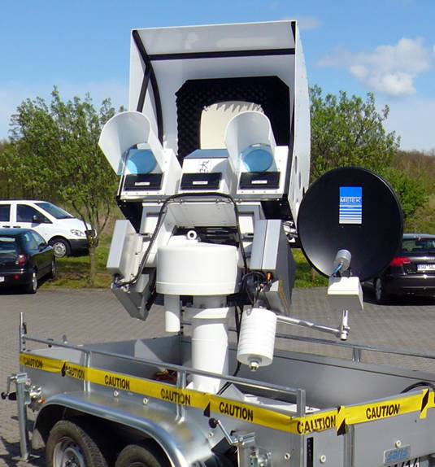
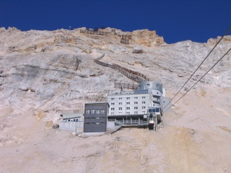
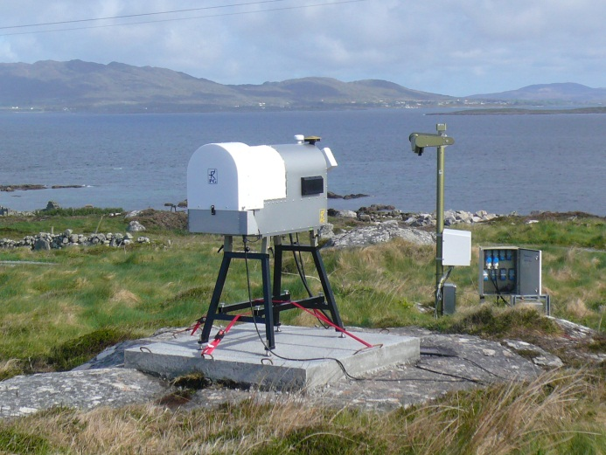
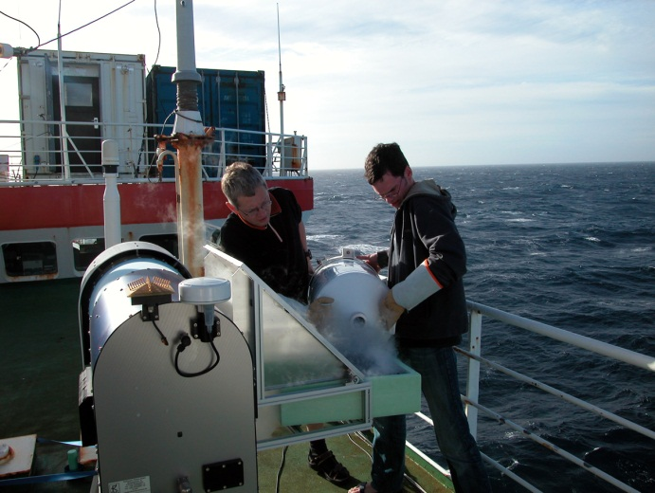
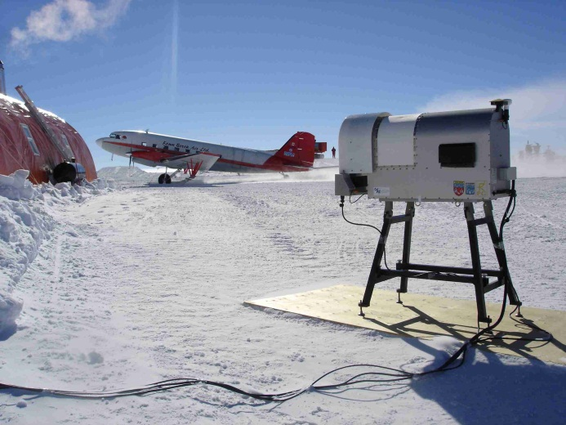
Radiometer Products
Approx. 25 standalone multi-channel radiometers per year

Slide 21






Radiometers Deployments
Lampedusa, Italy
(humid, hot, salty)
Dome-C, Antarctica
(3.300m, -25 to -80 °C)
Research Vessel “Polarstern”
(Atlantic Ocean)
ALMA site, Chile
(5.500m above sea level)
Zugspitze, Germany
(2.800m, -35 °C, 250km/h wind)
AMMA campaign, Benin
(West-Africa, hot climate, dust)

Slide 22







Radiometers Deployments
CAOS, Bangalore, India
Zugspitze, Germany, 2650 m asl
Kolkata, India
Eureka, Ellesmere Island, Canada
Ny-Alesund, Spitsbergen, Norway
Solar-Patroller (SST)

Slide 23




MWSC: Scintillomter @160 GHz for Latent Heat Flux

Slide 24

MWSC Integration

Slide 25
RPG-FMCW-94
RPG-FMCW-94-DP
A Cloud Radar by RPG
  Frequency Modulated, Continuous Wave, 94 GHz
  Low mode for fog, high mode up to 12 km
  Re-using RPG technology from Tx/Rx systems and network analysis
  Re-using instrument infrastructure (housing, steering, control, data processing) from microwave radiometers
  Supported by Fraunhofer Institute for RF Technology and Radar (FhG-FHR, Wachtberg, Germany, formerly FGAN)
  Availability: Mid of 2013

Slide 26

RPG-FMCW-94 Specifications (I)
Operating Frequency: 94 GHz +/-150 MHz
IF Range: 0.5 MHz to 1.3 MHz
Continuous Power: 500 mW (Solid State)
T/R Type: Bi-static
Antenna Diameter: 500 mm
Gain: 52 dB
Chirp Rate: 100 / sec
Chirp Variations: 7
Passive LWP Channel: 89 Ghz (optional)
Dynamic Range: -100 dBz to +20 dBz

Slide 27

RPG-FMCW-94 Specifications (II)
Ranging: 10 m to 12 km
Sampling Rate: 1 / 4 seconds
Vertical Resolution: 1 m (r: 10m - 600 m)
2 m (r: 0.6 – 1.0 km)
4 m (r: 1.0 – 2.5 km)
8 m (r: 2.5 – 5.0 km)
16 m (r: 5.0 – 12.0 km)
Doppler Resolution: +/- 15 cm/sec
Polarisation: v / h (optional)
  Availability: Mid of 2013
  Possible extensions by
  Additional frequencies
  Passive microwave channels
  Polarisation options

Slide 28
Reference Customers (selected)
ESA-ESTEC
NASA/JPL
EADS-Astrium
Thales-Alenia Space
SRON (Netherlands)
CNES (France)
DLR (Gerrmany)
Chinese Space Agency
(CAS, CSSAR, …)
IRAM
NIST (National Institute for Standards, USA)
PTB (German institute for standards)
CNRS (France)
ESO (European Southern Observatory)
Rohde & Schwarz
AB-millimetre
Aerospace Corporation (USA)
US Air Force, AFRL Research Labs
ROKAF (South-Korean Air Force)
ARM (Atmospheric Radiation Monitoring, USA)
KMA (Korean weather service)
CNRS (France)
UK Met Office
KNMI (The Netherlands weather service)
Meteo Swiss (Switzerland)
Polish weather service
Numerous Universities world wide
AWI Alfred Wegener Institute f. Polar Research
Numerous Universities and Research Institutions

